Slide 1




Structural Analysis of MBE Grown InGaAsSb Thin Films
Rosemary Wynnychenko
Mentors: Yu Wu and Teun Van Schijndel
PI: Chris Palmstrøm

Slide 2
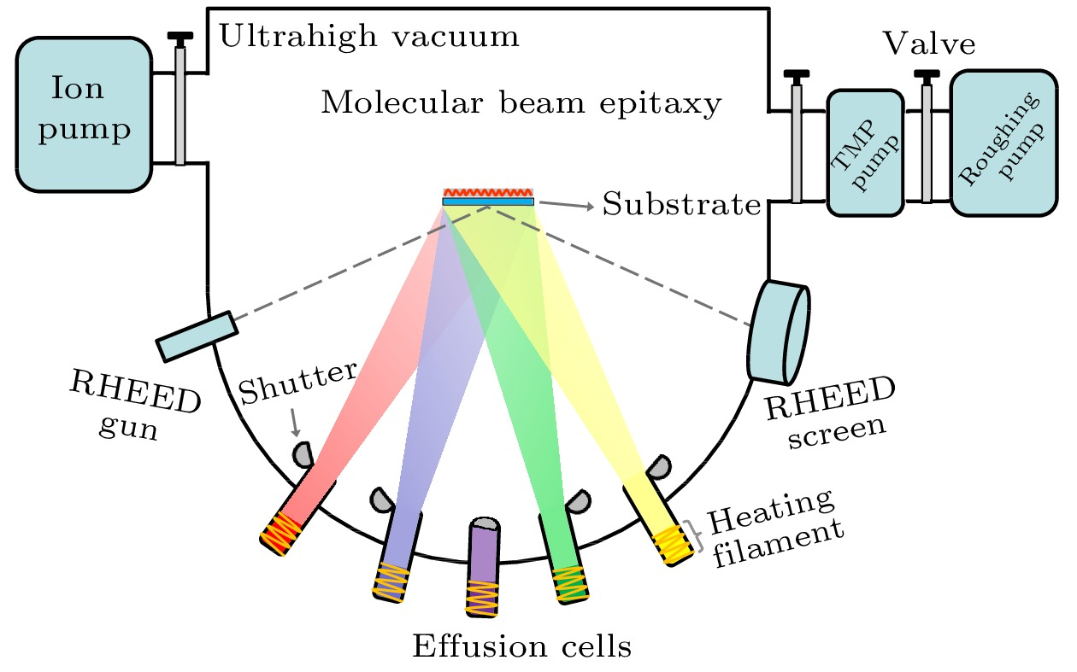
Molecular Beam Epitaxy: A Method of Growing Thin Films
https://wulixb.iphy.ac.cn/en/article/doi/10.7498/aps.71.20220727
https://resources.pcb.cadence.com/blog/2024-the-molecular-beam-epitaxy-mbe-process
Notes:
The samples characterized for this project are grown via MBE, or molecular beam epitaxy.
In MBE, a substrate is placed in an ultra high vacuum chamber and then effusion cells containing the elements one wishes to deposit on the substrate are heating up and the outcoming atoms are directed at the substrate, causing thin layers of atoms to grow on the substrate.
Because of the ultra high vacuum chamber, the mean free path of the molecules is high and as a result there’s no scattering between the effusion cells and the substrate.
Furthermore, in MBE the layers are grown very slowly leading to epitaxial growth, which is when the crystal pattern of the deposited thin film mimics the crystal structure of the substrate and the thin film that is grown is effectively a single crystal.

Slide 3
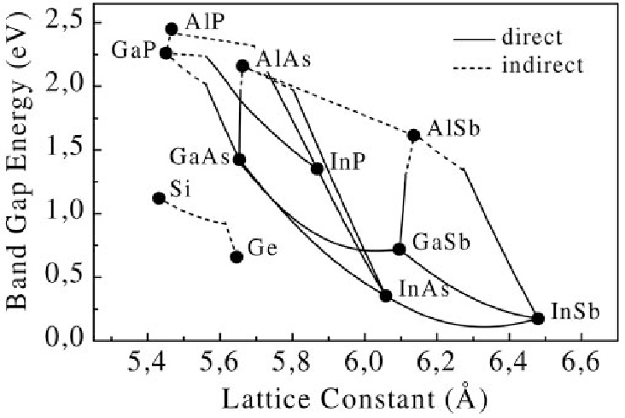
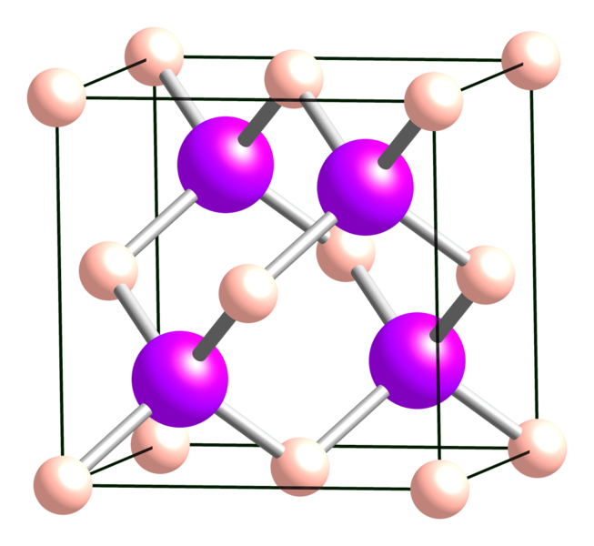
Semiconductor Compounds
Lattice constant of a cubic structure
Grow In_{0.5}Ga_{0.5}As_{y}Sb_{1-y} thin films using MBE
E.K. Müller, and J.L. Richards, “Miscibility of III‐V Semiconductors Studied by Flash Evaporation,” Journal of Applied Physics 35(4), 1233–1241 (1964).
A. Bett, D. Frank, G. Stollwerck, and O. Sulima, “III-V compounds for solar cell applications,” Applied Physics A 69, 119–129 (1999).
Notes:
One area of interest relates to combining different semiconductor compounds and thus growing new semiconductors with different electrical and optical properties.
Here is a graph of different semiconductor compounds showing their band gap energy and lattice constant. [explain lattice constant referencing diagram].
Imagine adding a little bit of Indium arsenide to GaAs. [show where this would be on the curve], could add more InAs, which would be a bit farther along the curve. The lattice constant of the film changes as more and more indium is added (as shown on the curve).
- Point out that it’s specifically moving towards InAs
That’s just combing three different elements
Goal of this project is to combine four
The goal is to have compound with equal components of Indium and Gallium and then very the percentages of As and Sb to get a lattice constant equal to GaSb, so the thin film is lattice matched to GaSb.

Slide 4
Why In_{0.5}Ga_{0.5}As_{y}Sb_{1-y} Lattice Matched to GaSb?
Possible uses in: thermophotovoltaics and infrared devices
Specific thermoelectric applications
Create structure which raises electrical conductivity without raising thermal conductivity -> more efficient thermoelectrics
Heat Sink
p-doped InGaAsSb
intrinsic InGaAsSb
n-doped InGaAsSb
10x
n-doped InAsSb
intrinsic InAsSb
p-doped InAsSb
Heat Source
Notes:
InGaAsSb generally has possible uses in: thermophotovoltaics and infrared devices such as detectors, imaging, LEDs and lasers
For InGaAsSb lattice matched to GaSb there are specific applications:
Create structure with p/i/n doped layers which raises electrical conductivity without raising thermal conductivity -> this leads to more efficient thermoelectric devices
Theoretical predictions: In_{0.5}Ga_{0.5}AsSb lattice matched to GaSb is most efficient
“In semiconductor physics, n-doped and p-doped materials are created by adding specific impurities to a semiconductor to alter its electrical conductivity. N-type doping introduces extra electrons (negative charge carriers), while p-type doping introduces "holes" (positive charge carriers).This distinction significantly impacts the material's behavior in electronic devices”

Slide 5
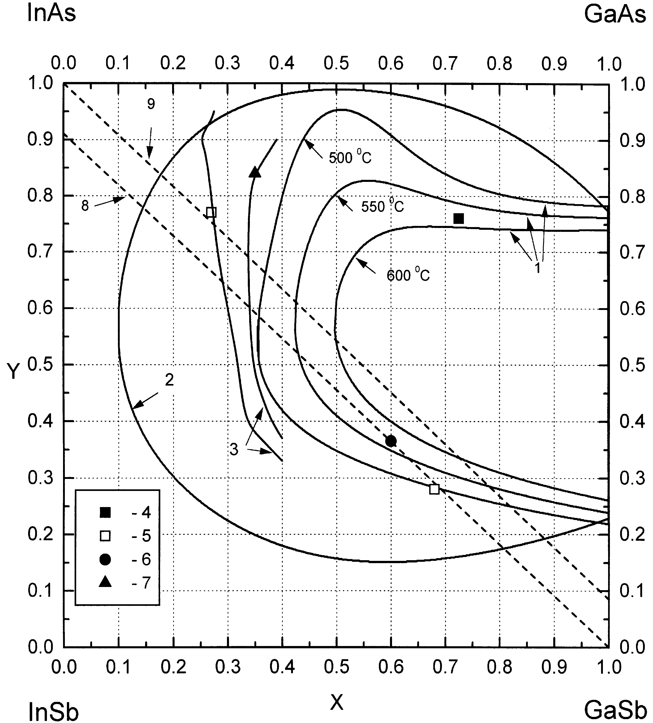
Miscibility Gap in InGaAsSb
MBE growth temperatures:
400-600 °C
V.S. Sorokin, “Novel approach to the calculation of instability regions in GaInAsSb alloys”, Journal of Crystal Growth, 216 (2000). https://doi.org/10.1016/S0022-0248(00)00363-8
Notes:
However, this is difficult because of something called the miscibility gap, which is when a homogenous solution does not form after the elements are deposited and instead there is phase separation.
Can see phase diagram
This is a theoretical prediction of the miscibility gap – area inside curve is in the miscibility gap
Different curves show different temperatures
– red line shows composition we want to grow at
At MBE temperatures – we’re always in the miscibility gap
Previous work:
Sabardeil et al : varied Ga composition in GaAsInSb alloys latticed matched to GaSb:
At <40% Ga or >80% Ga -> good crystal quality
For 50% Ga -> there was poor crystal quality, indicating a miscibility gap (broad XRD peak indicating altered crystal quality)
Müller and Richards:
combined different semiconductor compounds
at ~50% in InAs-GaSb or GaAs-InSb compositions, there’s a wide composition range (indicated by broad XRD peaks)
-> miscibility gap
Sabardeil et al: GaAsInSb films latticed matched to GaSb; vary Ga composition:
<40% Ga or >80% Ga ⇒ good crystal quality
~50% Ga ⇒ altered crystal quality
Müller and Richards: combined different semiconductor compounds
at ~50% mix of InAs-GaSb or GaAs-InSb: there’s a wide composition range in the resulting alloy
Muller: crushed 3-5 compounds into powder and evaporated using flash evaporation different than MBE – less controlled, rapid vaporization; higher substrate temperature -> then completely separate peaks
Sabardeil et al : above 80% or below 40% can be used for infrared applications; perhaps with gap can be decreased by optimizing growth conditions
Sabardeil et al, “MBE growth and properties of InGaAsSb alloys deep inside the miscibility gap”, Journal of Crystal Growth 657, 128107 (2025).
E. K. Müller and J. L. Richards, “Miscibility of iii-v semiconductors studied by flash evaporation”, Journal of Applied Physics 35, 1233 (1964).

Slide 6
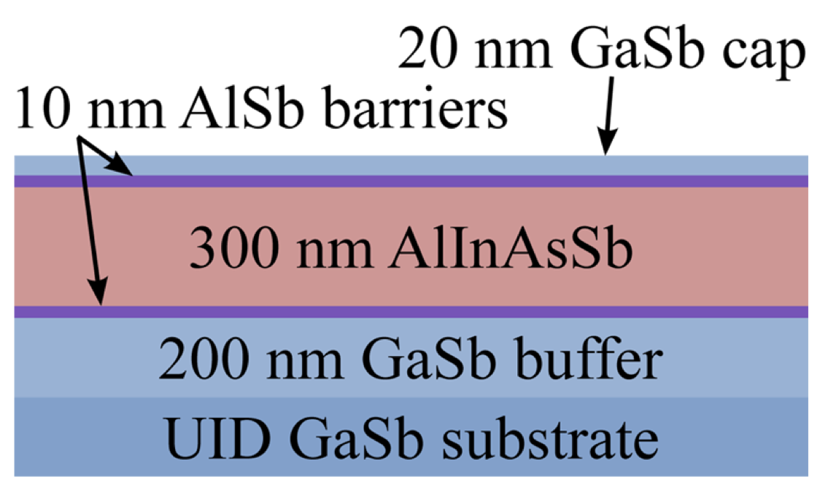
Avoiding the Miscibility Gap
Use a digital alloy (Maddox 2016)
Rely on MBE being a non equilibrium growth process
S. J. Maddox, S. D. March, and S. R. Bank, “Broadly tunable alinassb digital alloys grown on GaSb”, Crystal Growth & Design 16, 3582 (2016), https://doi.org/10.1021/acs.cgd.5b01515.
V.S. Sorokin, “Novel approach to the calculation of instability regions in GaInAsSb alloys”, Journal of Crystal Growth, 216 (2000). https://doi.org/10.1016/S0022-0248(00)00363-8
Notes:
How will this project work towards growing a InGaAsSb sample lattice constant to GaSb?
Two methods of avoiding the miscibility gap
Use a digital alloy; done previously with AlInAsSb lattice matched to GaSb
This is when you create different layers that together mimic the compound you hope to grow without actually growing that compound
Can this this in picture on the bottom
One of the ways this has been done in the past
The second method is relying on MBE being an non equilibrium process
Non equibiibrium process -> can access a metastable phase that’s not accessible via other growth mechanism
Low enough temperature -> lack of sufficient kinetic energy to phase separate -> no phase separation
______________________________________________________________
“Fig. 2. Spinodal isotherms in GaInAsSb in comparison with available experimental data: 1* calculation of this work; 2* calculation using expression (6) at 1"800 K [12]; 3* experi- mental data of Nakajima et al. [10], LPE; 4* experimental data of Vasil'ev et al. [23], LPE, 1"575}6003C; 5* experimental data of Cheng et al. [24], MOVPE, 1"4863C; 6* experi- mental data of Cheng et al. [24], MOVPE, 1"6003C; 7* experimental data of Baranov et al. [25], MBE, 1"4803C; 8* line of compositions lattice-matched to GaSb; 9* line of com- positions lattice-matched to InAs. “

Slide 7
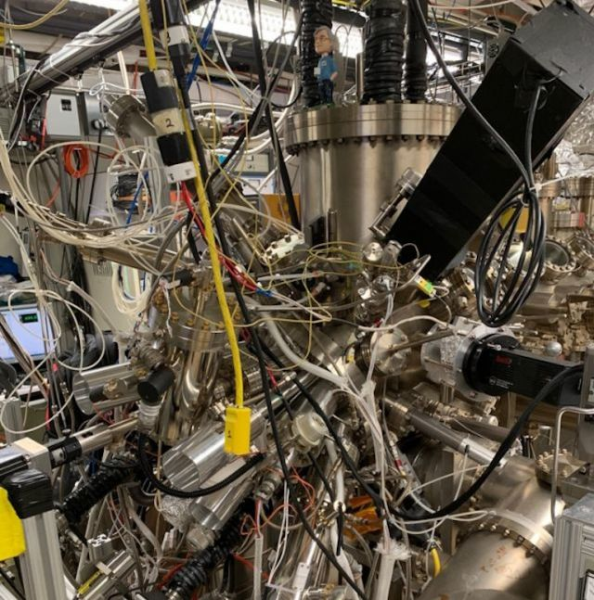
Project Goals
For InGaAsSb thin films grown via MBE:
Utilize X-ray diffraction (XRD) to calculate lattice constant
Analyze XRD data along with growth conditions
Final goal: grow In_{0.5}Ga_{0.5}As_{y}Sb_{1-y} lattice matched to GaSb
https://palmstrom.cnsi.ucsb.edu/facilities/materials-growth
Notes:
For InGaAsSb thin films grown via MBE:
Utilize XRD to calculate lattice constant
Analyze XRD data along with growth conditions to determine how growth conditions effect the lattice constant
Final goal: grow In.5Ga.5AsSb lattice matched to GaSb

Slide 8
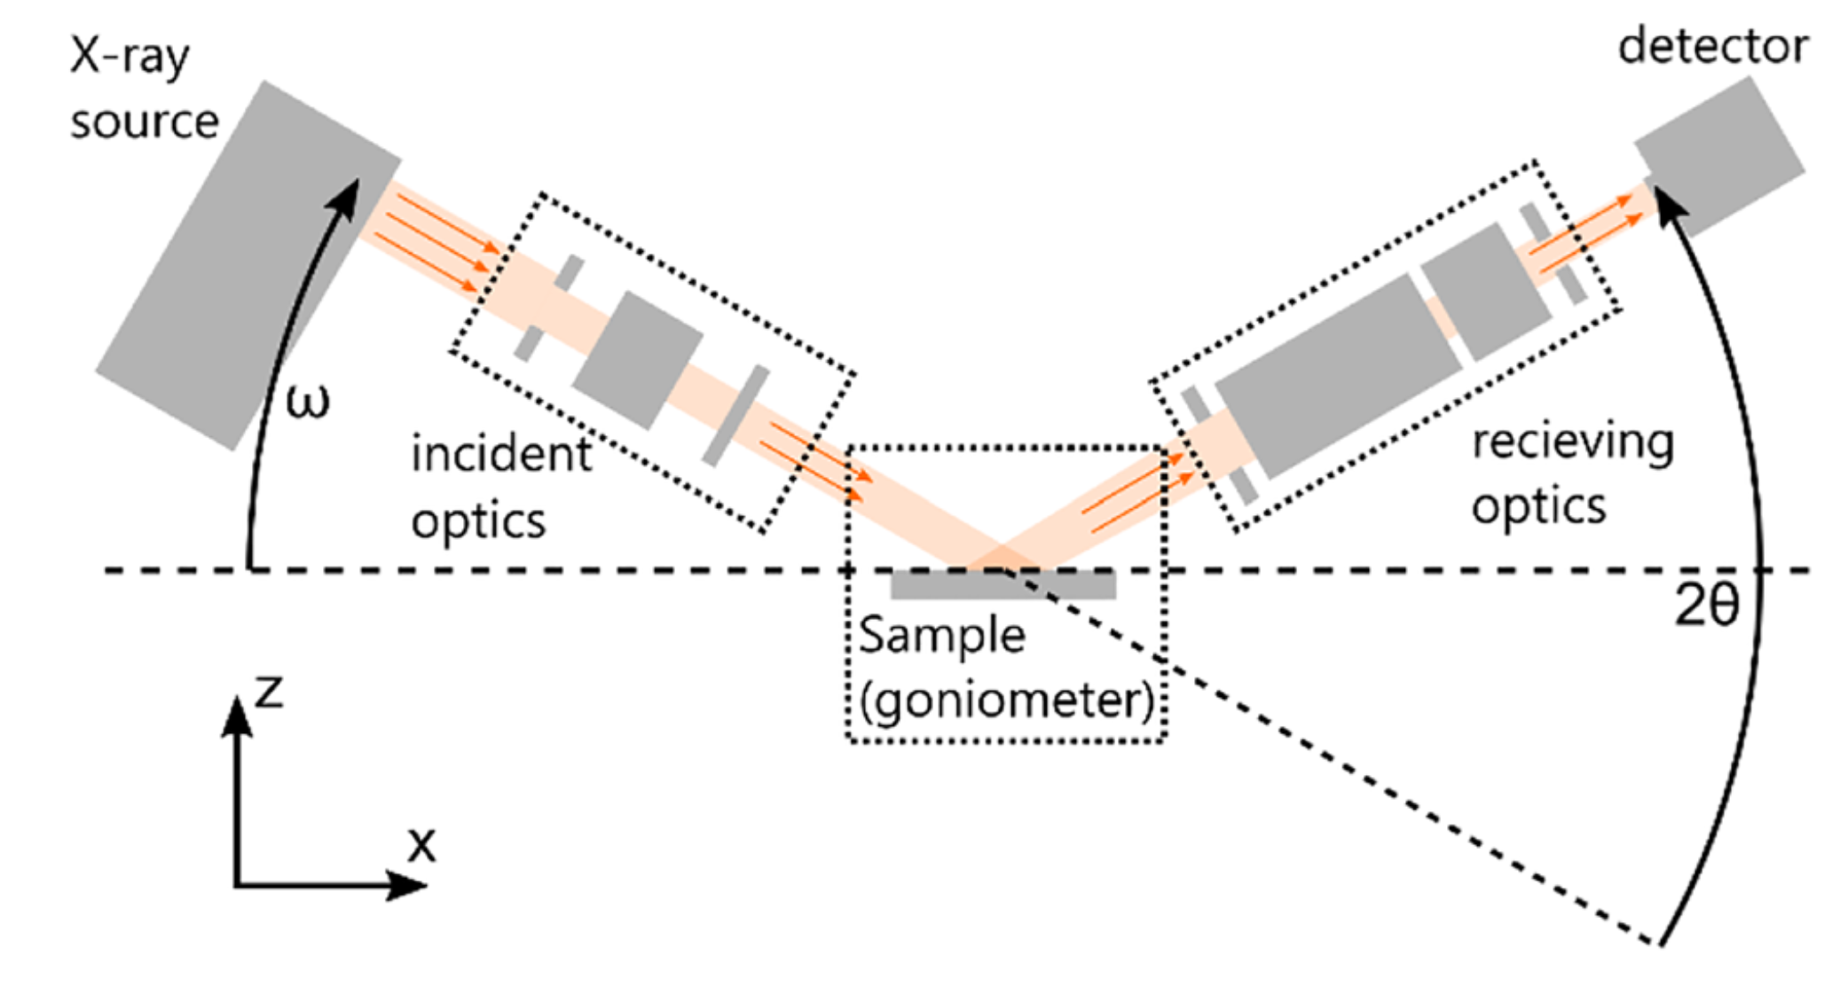
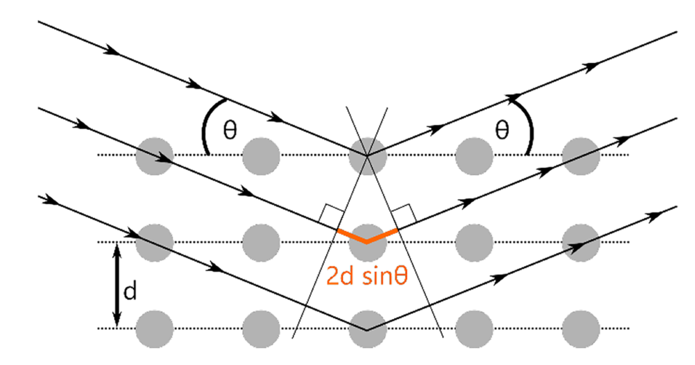
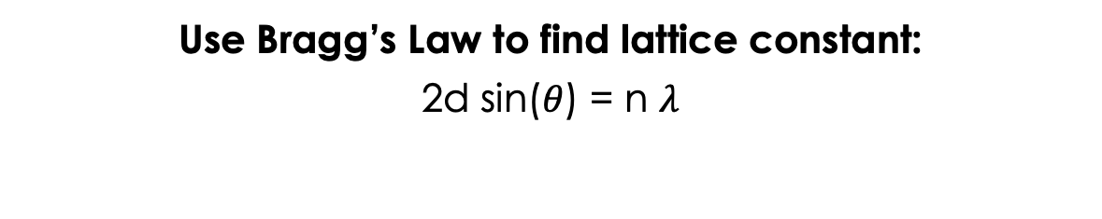
X Ray Diffraction (XRD) & 2$θ/ω$ Scans
Use Bragg’s Law to find lattice constant:
2d sin($θ$) = n $λ$
G.F. Harrington, and J. Santiso, “Back-to-Basics tutorial: X-ray diffraction of thin films,” Journal of Electroceramics 47(4), 141–163 (2021).
Notes:
In order to study the crystallinity of a material and its lattice constant, we use x ray diffraction, or XRD
X rays are reflected off the surface of a sample – as shown in the left hand figure – and the reflected beam is sent to a detector
We use a specific type of scan called a 2$θ/ω$ scan, this is when omega is kept to half of the 2 theta angle.
Can see a diagram of this on the right
Some x rays reflect off of first layer of atoms, some off the second, and so one.
For x rays reflected off the surface of a sample, there will be a path length difference between x rays reflected off of the first layer versus those in the second layer and so on
When this path length difference is the multiple of the wavelength of the x rays, there will be constructive interference – leading to peaks in the signal detected. When this path length difference is not the multiple of the wavelength of the x rays, there will be destructive interference.
2dsin theta = path length difference
N lambda = multiple of wavelengths
Bragg’s law
use this to calculate lattice constant based on the peak locations

Slide 9
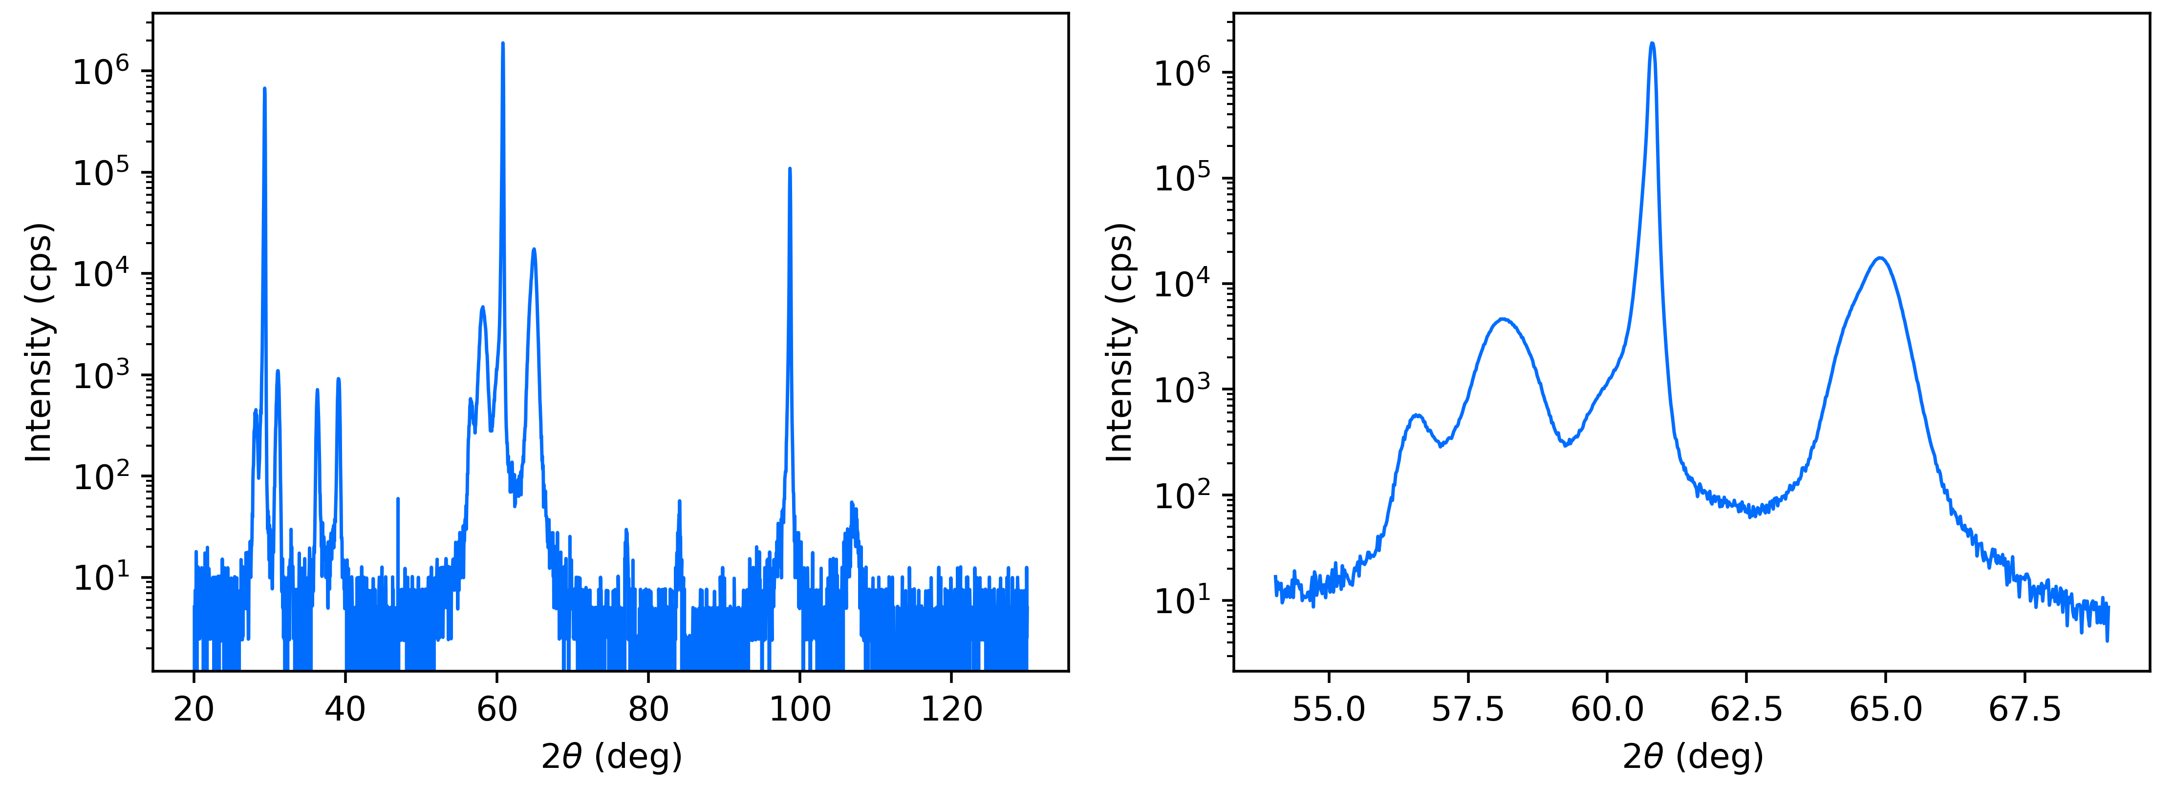
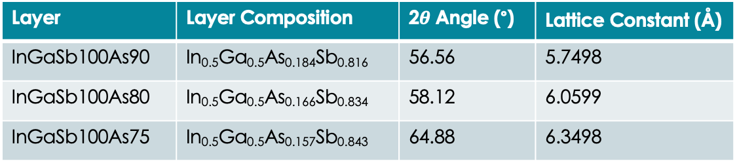



Experimental Data
60.8°
64.88°
5.7498 $\text{Å}$
58.12°
6.3498 $\text{Å}$
56.56°
6.5099 $\text{Å}$
Layer | Layer Composition | 2$θ$ Angle (°) | Lattice Constant ($\text{Å}$)
InGaSb100As90 | In_{0.5}Ga_{0.5}As_{0.184}Sb_{0.816} | 56.56 | 5.7498
InGaSb100As80 | In_{0.5}Ga_{0.5}As_{0.166}Sb_{0.834} | 58.12 | 6.0599
InGaSb100As75 | In_{0.5}Ga_{0.5}As_{0.157}Sb_{0.843} | 64.88 | 6.3498
Notes:
This is example XRD data.
Left graph: data from 20 to 130 degrees
Right graph: zoomed in data for the first order peak – the one in the middle
Both intensity as a function of theta
This sample has a substrate and then three different layers grown on top, we see sets of 4 peaks.
There are multiple different sets of peaks because there are different orders of reflection
Then using braggs law we calculate the lattice constant corresponding to each peak.
From there, each lattice constant can be correlated with a layer of the sample.
We know the sample composition based on the valve values during growth
And we know that Sb has a higher lattice constant that As
So films higher in Sb have a higher lattice constant
So by doing this for many samples, we can begin to correlate growth conditions with the lattice constant of the resulting sample.
RW notes
300 nm for each layer
YW092
T=500C

Slide 10
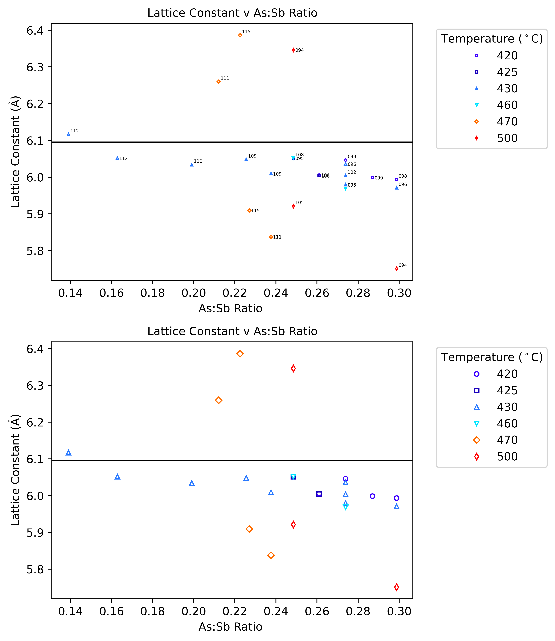
Lattice Constant v Composition
Notes:
Data points corresponding to the different samples
Lattice constant v composition ratio
Different colors correspond to different temperatures
Black line – lattice constant of GaSb

Slide 11
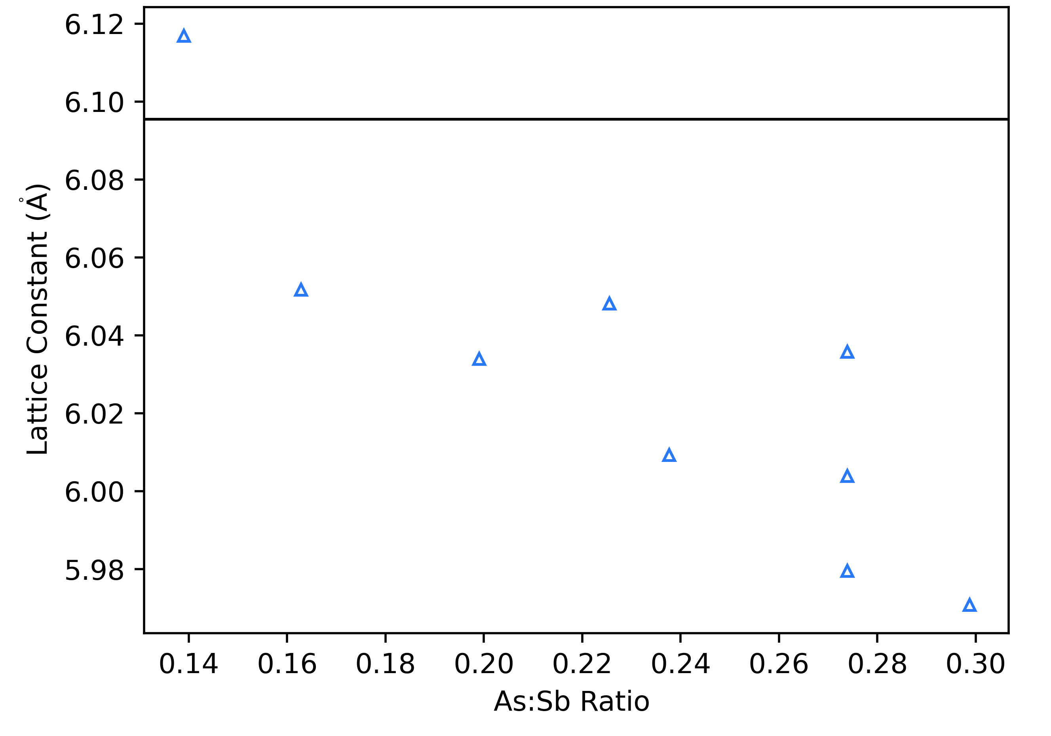
Lattice Constant v Composition
See linear trend at 430 °C
Achieved lattice constant of 6.1169 Å
Difficulties measuring temperature in a vacuum
Notes:
Explain outlier points for 430 degrees
Get close to GaSb lattice constant (within 0.35 % of GaSb)
Why is the data noisy
It’s difficult to measure temperature in a vaccum
Use pyrometer to measure temperature
Measures infrared radiation emitted by object
This isn’t perfect so the data is noisy
Different sample holders have different emissivity – inconsistencies between sample holders
YW112
300nm In0.5GaSb300As 65 - As_0.14 Sb_0.86 - 6.0518
300nm In0.5GaSb300A 60 - As_0.131 Sb_0.869
300nm In0.5GaSb300As 55 - As_0.122 Sb_0.878 - 6.1169
Temp 430C

Slide 12
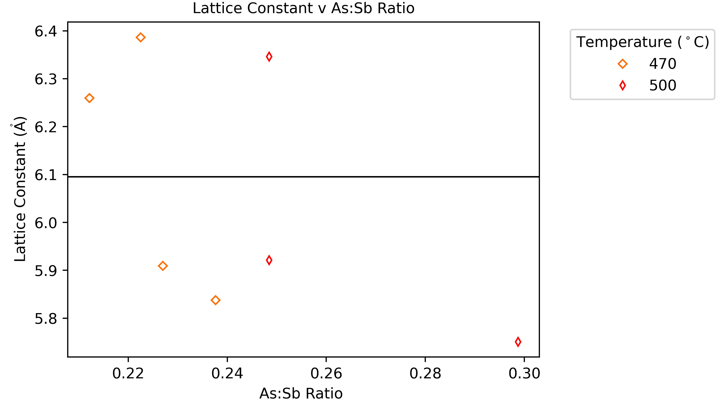
Lattice Constant v Composition
470 °C or above: rapid increase at values close to the lattice constant

Slide 13
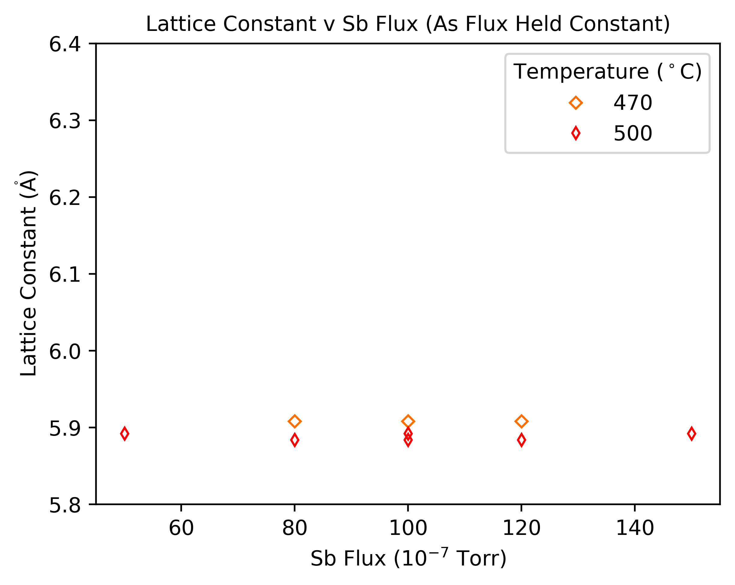
Sb Flux does not Impact the Lattice Constant
Only Arsenic flux matters for determining the lattice constant
Antimony sticks better
Notes:
As flies off at lower temperatures – around 400 C
As and Sb tend to fly off above 400 C
As is more volatile
Under same Temperature As flys off more

Slide 14
Conclusion & Next Steps
Lattice constant of 6.1169 Å achieved
More measurements at higher temperature
More measurements at temperatures of 420 °C and 425 °C
Notes:
Lattice constant of 6.1169 (Å) achieved – within 1% of the lattice constant of GaSb- 6.095
.34% of lattice constanf of GaSb 6.0955
More measurements at higher temperature (470, 500) to investigate and confirm the pattern of rapid increase
More measurements at temperatures of 420 °C and 425 °C to try to get even closer to GaSb lattice constant
YW112
300nm In0.5GaSb300As 65 - As_0.14 Sb_0.86 - 6.0518
300nm In0.5GaSb300A 60 - As_0.131 Sb_0.869
300nm In0.5GaSb300As 55 - As_0.122 Sb_0.878 - 6.1169
Temp 430C

Slide 15



Acknowledgements
A special thanks to: Professor Chris Palmstrøm, Yu Wu, Teun van Schijndel, the Palmstrøm Lab, Professor Sathya Guruswamy
This work is supported by NSF REU grant PHY-2349677.

Slide 17
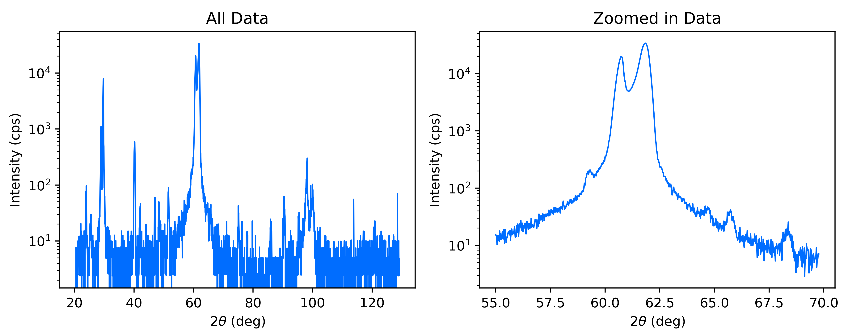
Too Low of a Temperature
60.73
61.84
Add graph here
59.31
64.68
65.73
68.38
Sample grown at 400 °C -> phase separation
Notes:
YW097
300nm In0.5GaSb300As 120 -> As_0.192 Sb_0.808 -> 5.9955
300nm In0.5GaSb300As 110 -> As_0.179 Sb_0.821 -> 5.9955
300nm In0.5GaSb300As 100 -> As_0.161 Sb_0.839 -> 6.2288
Temp 400C

Slide 18
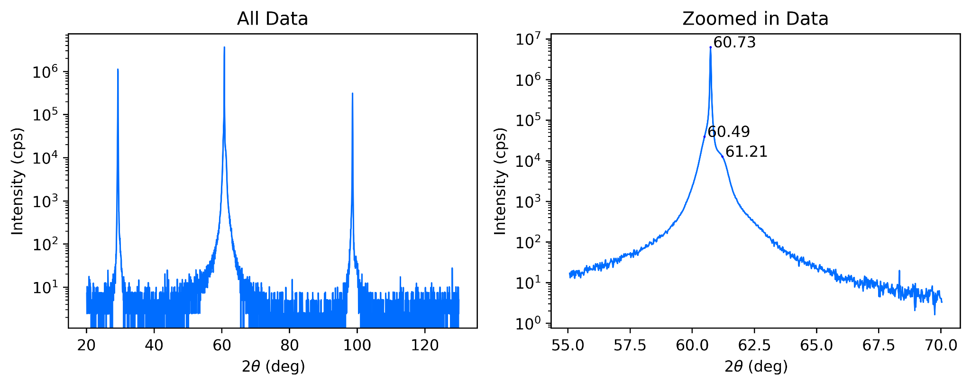
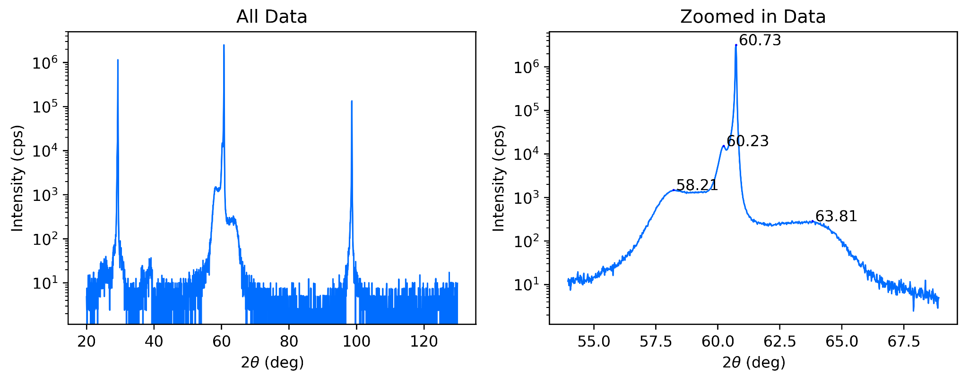

Slide 19
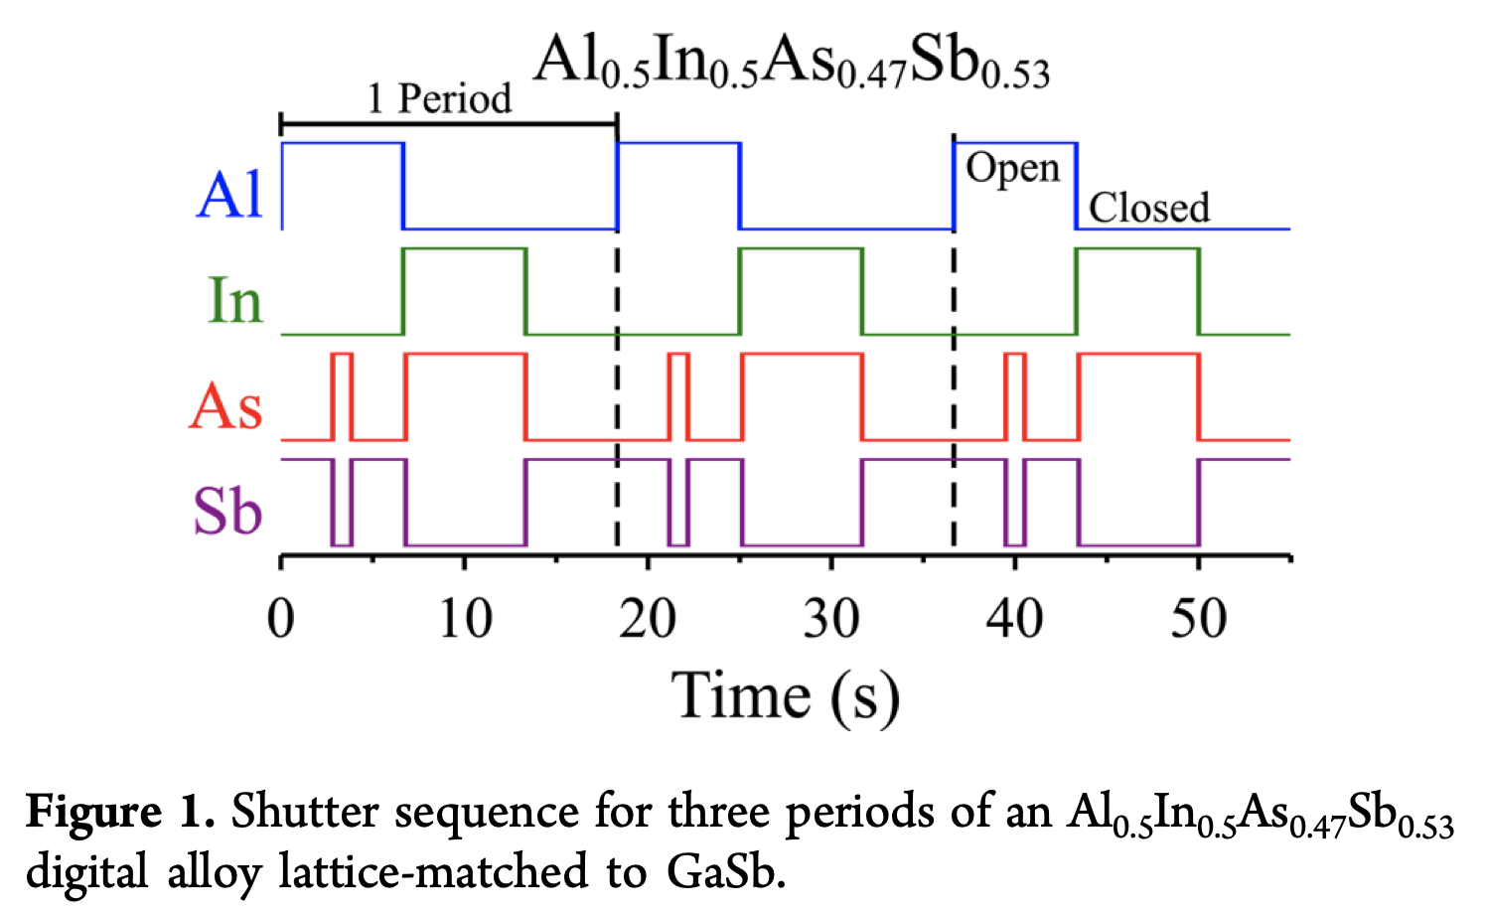

Slide 20
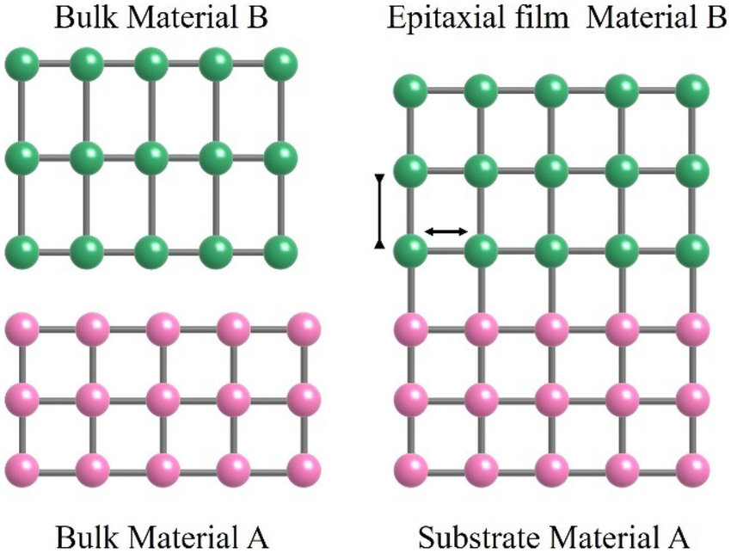
https://www.researchgate.net/figure/Lattice-mismatch-of-the-film-and-substrate_fig3_368222418

Slide 21
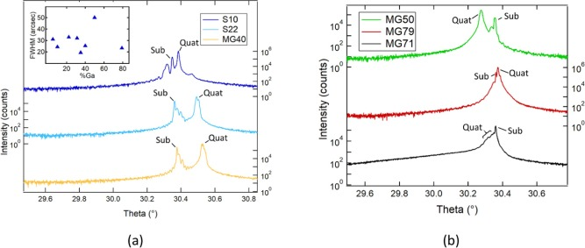
Sabardeil et al

Slide 22
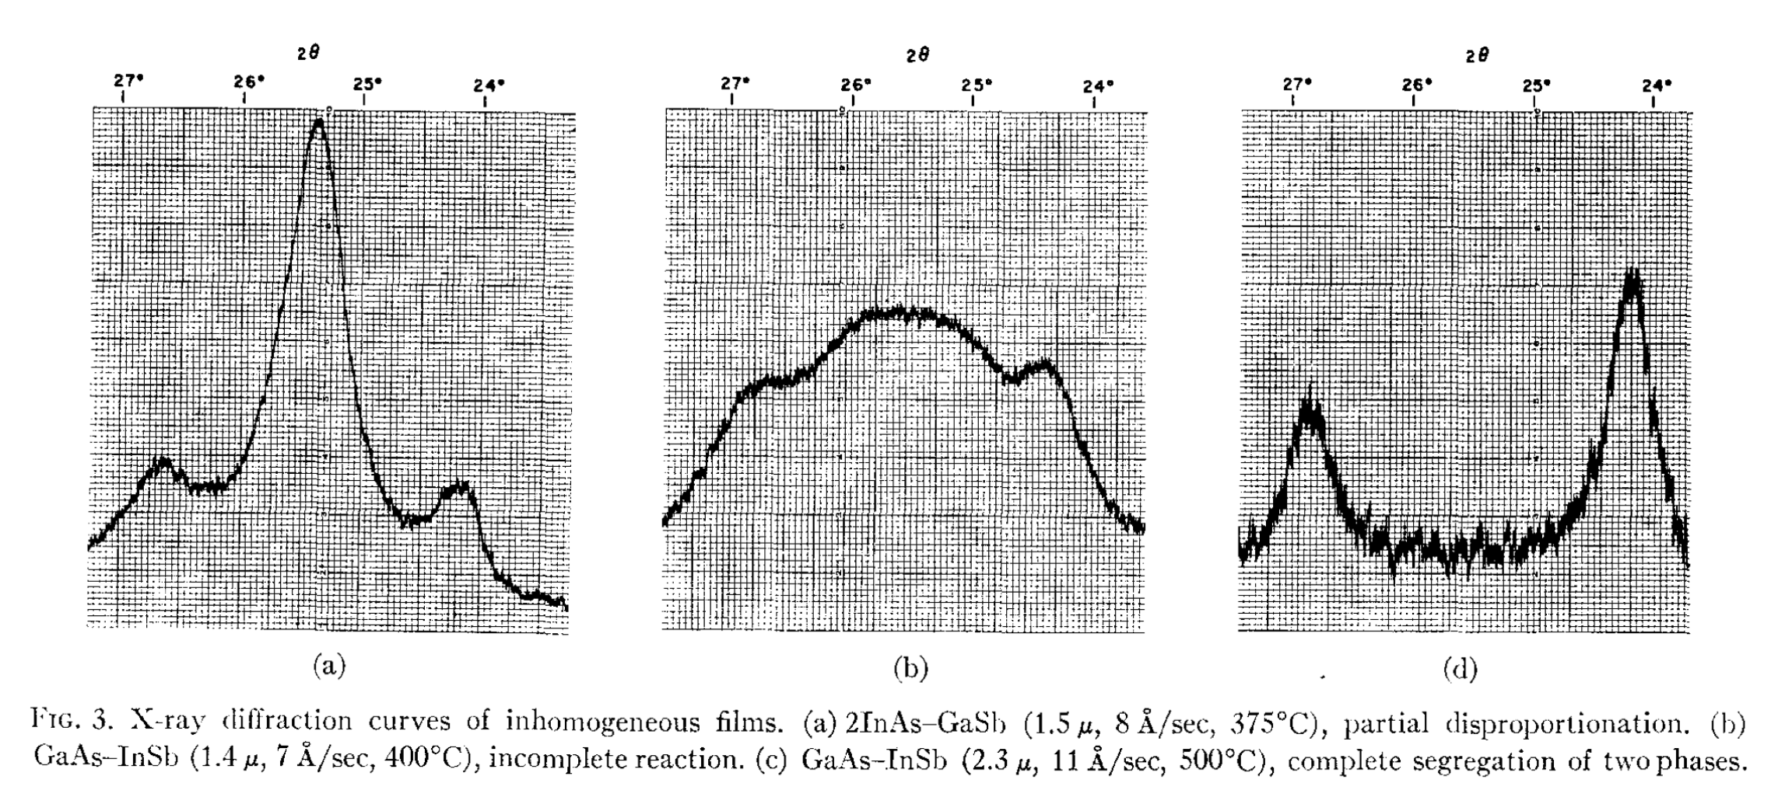
Müller and Richards

Slide 23
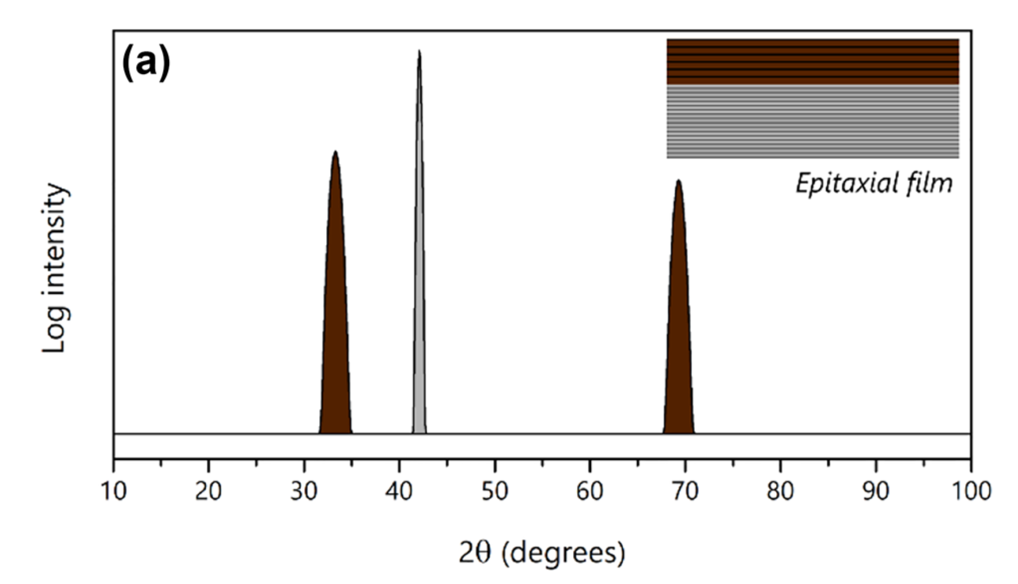
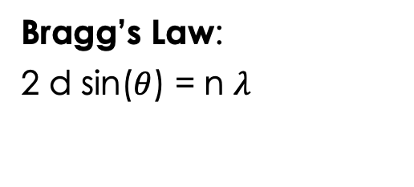
2$θ/ω$ Scans for Epitaxial Films
Bragg’s Law:
2 d sin($θ$) = n $λ$
Simulated data
E.K. Müller, and J.L. Richards, “Miscibility of III‐V Semiconductors Studied by Flash Evaporation,” Journal of Applied Physics 35(4), 1233–1241 (1964).
G.F. Harrington, and J. Santiso, “Back-to-Basics tutorial: X-ray diffraction of thin films,” Journal of Electroceramics 47(4), 141–163 (2021).
Notes:
Using 2$θ/ω$ scans of materials deposited via MBE, one can determine whether a solid solution forms between the GaAs and InSb. If a solid solution does not form, one will see peaks in the scan corresponding to both the substrate and GaAs and InSb separately. However, if a solid solution does form, we will only see a set of peaks peaks corresponding to that solid solution and epitaxial film, which is what is shown in the graph.
You can see this with the graph of simulated data for an epitaxial film on the left where the middle peak is from the substrate, the left peak is from first order interference, and the right peak if from second order interference – and is thus smaller in magnitude.
Then using braggs law, we can find the lattice constant of the resulting film, there theta is half the two theta angle, l is the wavelength, n is the order of reflection, and d is the lattice constant.
So we can find the lattice constant from a two theta omega scan.

Slide 24
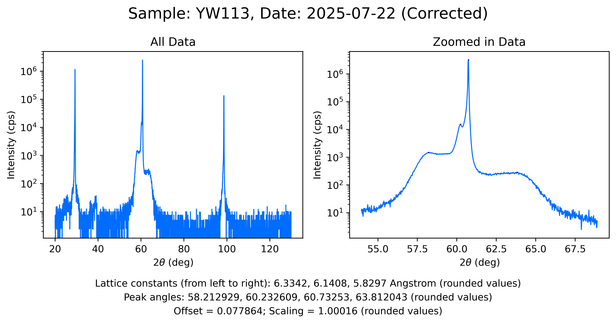
a)
b)
60.73
60.23
58.21
63.81

