Slide 1
Constructing a Hodoscope for the MilliQan experiment:
Searching for fractionally charged particles at the
Large Hadron Collider
Natalie McGee
Ryan Schmitz, Graduate Mentor and David Stuart, Faculty Mentor

Slide 2
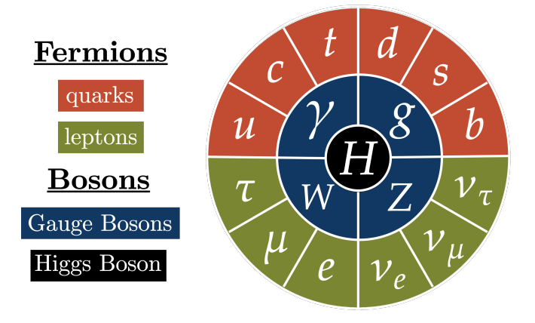
MilliQan Experiment and Millicharged Particles
Looking for a dark matter candidate — a millicharged particle
Approximately 1/1000th the electron charge
Under the current standard model, these particles do not exist
+
But the standard model is incomplete
Addition of a “Dark Sector” model
Image Credit: Samuel Alcott
Notes:
The Milliqan experiment is looking for dark matter. In particular, a theoretical dark matter candidate we call a millicharged, or fractionally charged, particle.
However, we know our current understanding of the standard model is incomplete, because we know of several well-founded observations that it fails to account for, not least of which is the existence of dark matter.
One plausible theory of dark matter, and the one that would imply the existence of a fractionally charged particle, extends the standard model by adding what is known as a “dark sector”
If you’re familiar with the standard model, you
This is one of the simplest extensions that can be made to the standard model. If you add a dark photon and the other properties that go along with it such as dark fermions that possess a dark charge, the math works out to show that dark fermions are capable of coupling with regular photons—but very weakly. This would show up as a particle with a very small charge, on the order of 1/1000th of an electron charge.

Slide 3
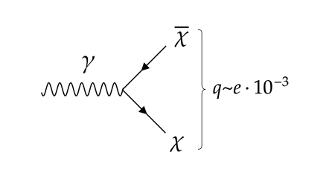
The Dark Sector
An implication of the Dark Sector addition:
Kinetic mixing between the dark sector and standard model terms
The dark fermion would be able to couple with a regular photon…
… but only very weakly
This would look like a particle with an extremely small electric charge!

Slide 4
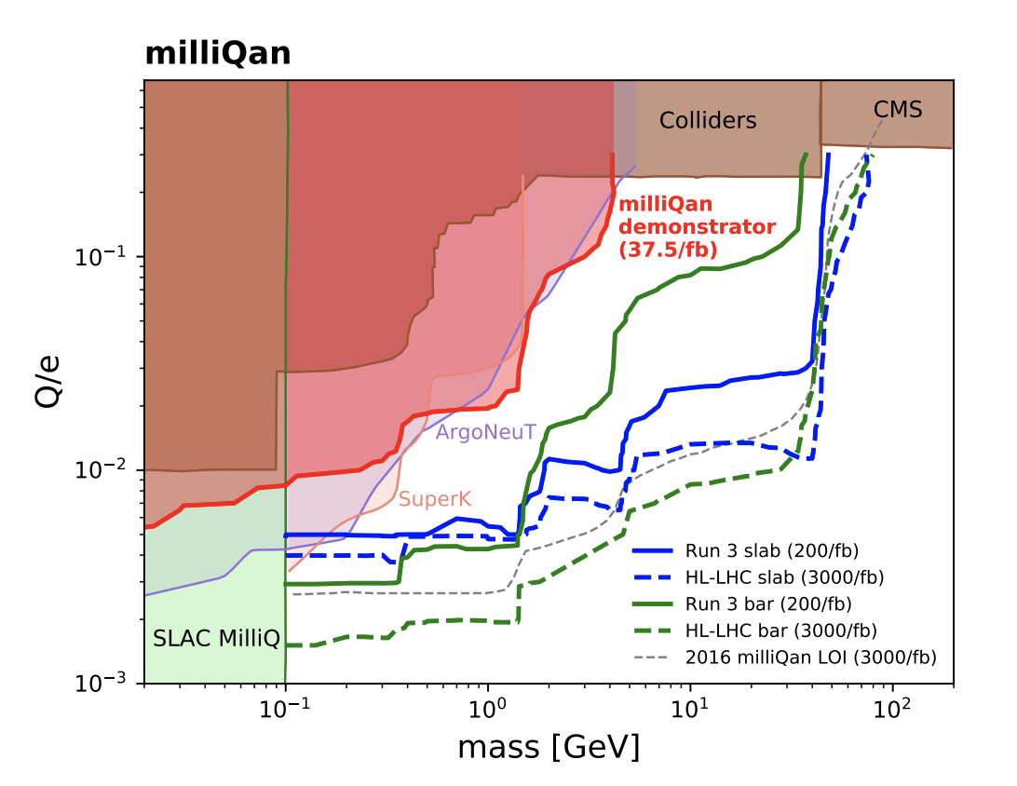

Slide 5
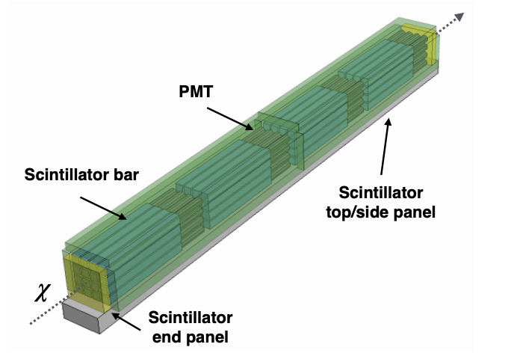
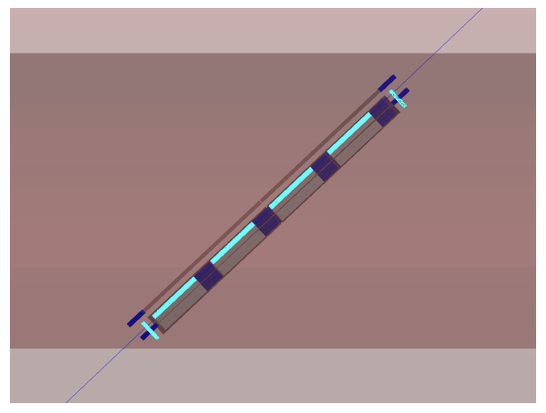
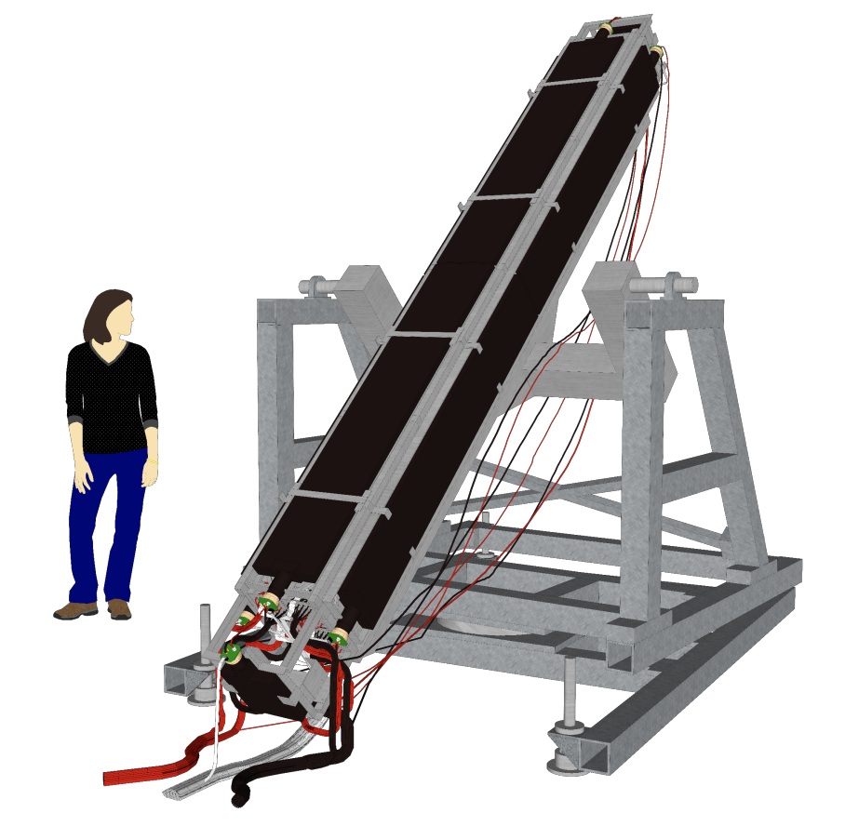
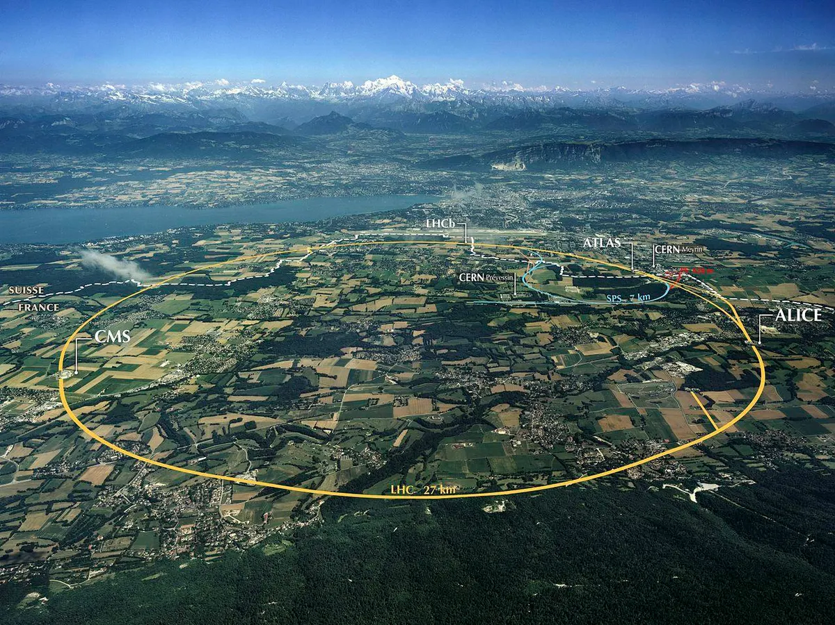
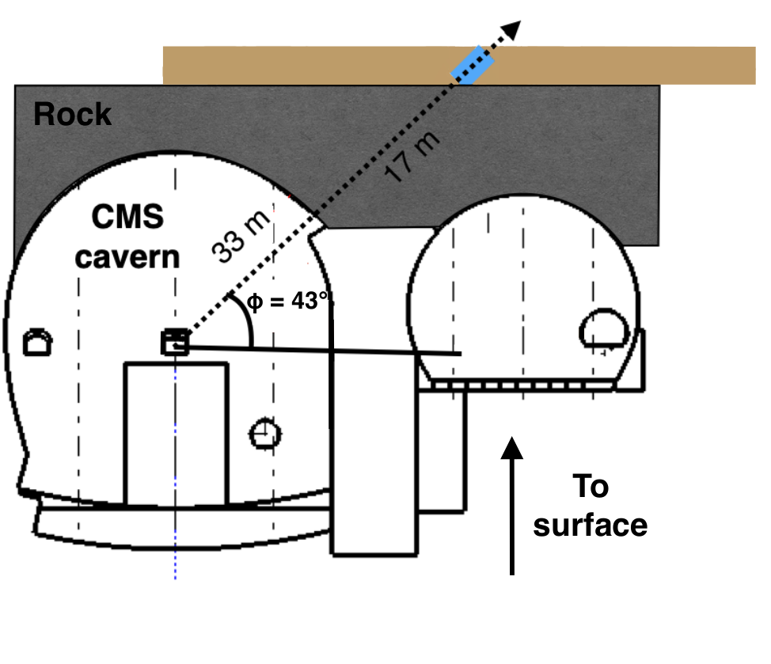
MilliQan Bar Detector
Made of 64 bars of scintillating plastic arranged in four “layers”
Each bar has a PMT (light detector) on the end
LHC
https://www.forbes.com/sites/startswithabang/2021/09/07/the-3-reasons-why-cerns-large-hadron-collider-cant-make-particles-go-faster/

Slide 6
Purpose of the Hodoscope
“Hodo” meaning “Path”
Allows us to track the path of certain particles
Primary purpose is detecting muons
Alignment purposes
Deconstructing background signals
Calibrating other detectors

Slide 7
Hodoscope Design
2 panels of 16 scintillator bars
Oriented perpendicular to each other
Provides x- and y- coordinates
Multiple layers at the beginning and end of detector

Slide 8
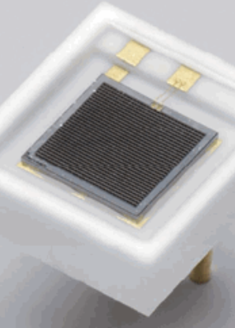
Design and Construction Plan
Understand and use SiPM detectors
Design structural
and light-reducing components
Image: Adafruit.com
Test and modify electronics for
processing signals
Use Raspberry Pi Pico to send data
Image: Hamamatsu.com

Slide 9
Electronics Flow
Amplifier Board
Digitizer Board
Raspberry Pi Pico
I
V
V
Internet Database
t
t
t

Slide 10
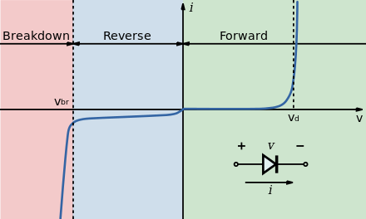
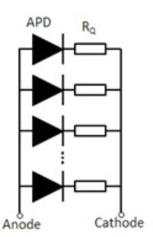
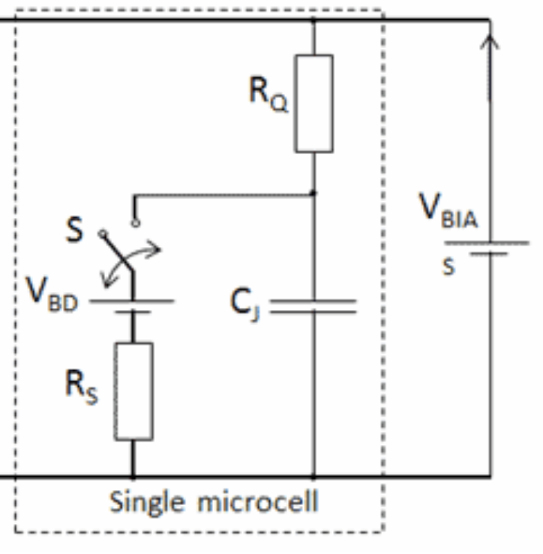
Silicon Photomultiplier (SiPM)
Light-sensitive diode
Reverse-biased to just above breakdown voltage
Absorb a photon, cause an avalanche
Generate a time-varying current signal
Images: Hamamatsu.com

Slide 11
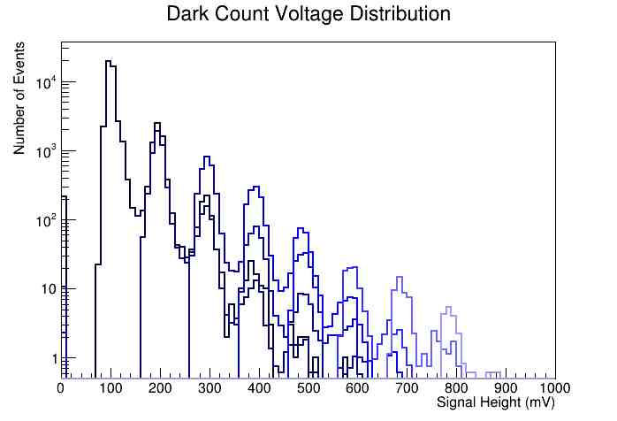
Measuring Dark Count
Noise caused by random generation of individual photons within the SiPM
First task: measure Hamamatsu SiPM “Dark Count”

Slide 12
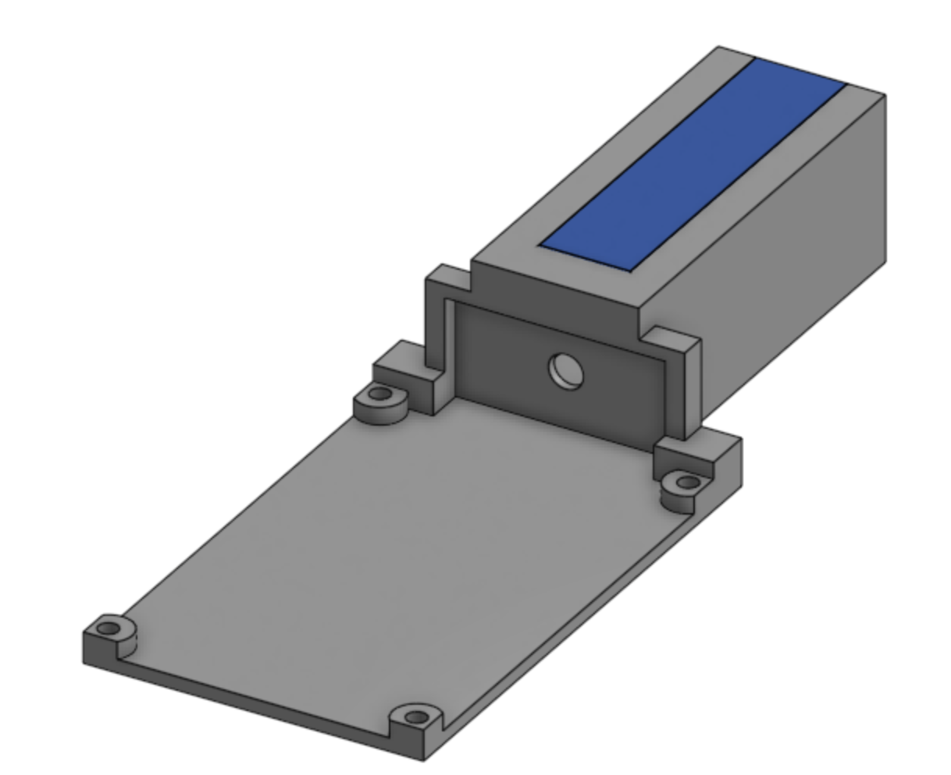
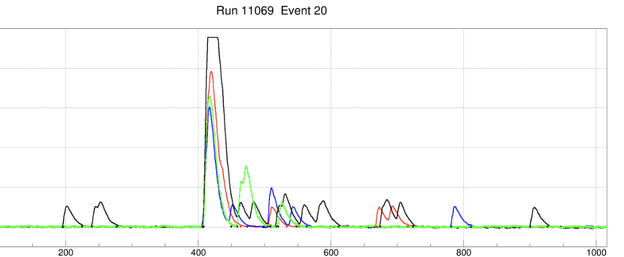
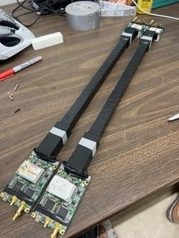
Using SiPMs to Detect Cosmic Muons
Attach SiPMs to scintillator bars
Multiple coincident measurements increase confidence
4 Hamamatsu SiPMs on 2 stacked bars
1000
800
600
Signal Voltage (mV)
400
200
0
Time (ns)

Slide 13
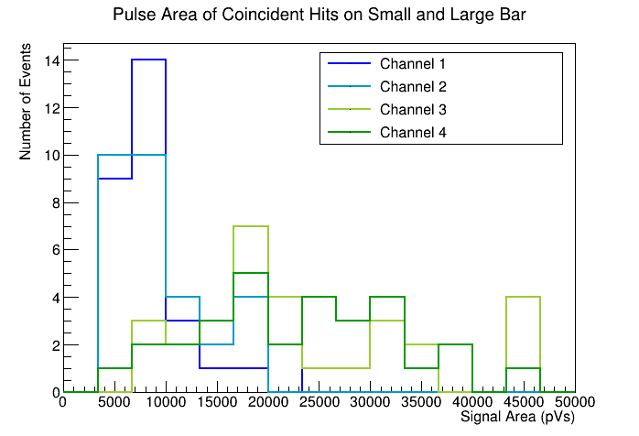
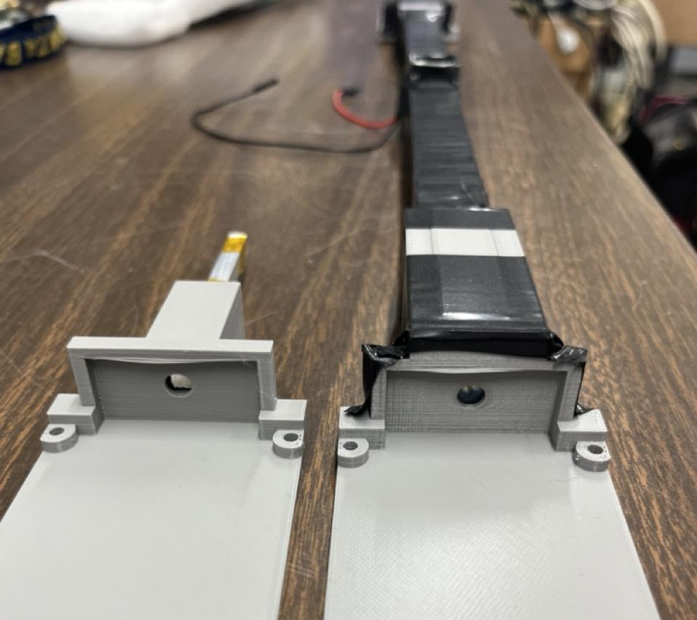
Scintillator Geometry
Size and shape of scintillator impacts detection efficiency
Measure coincident events on small and large scintillator bars

Slide 14
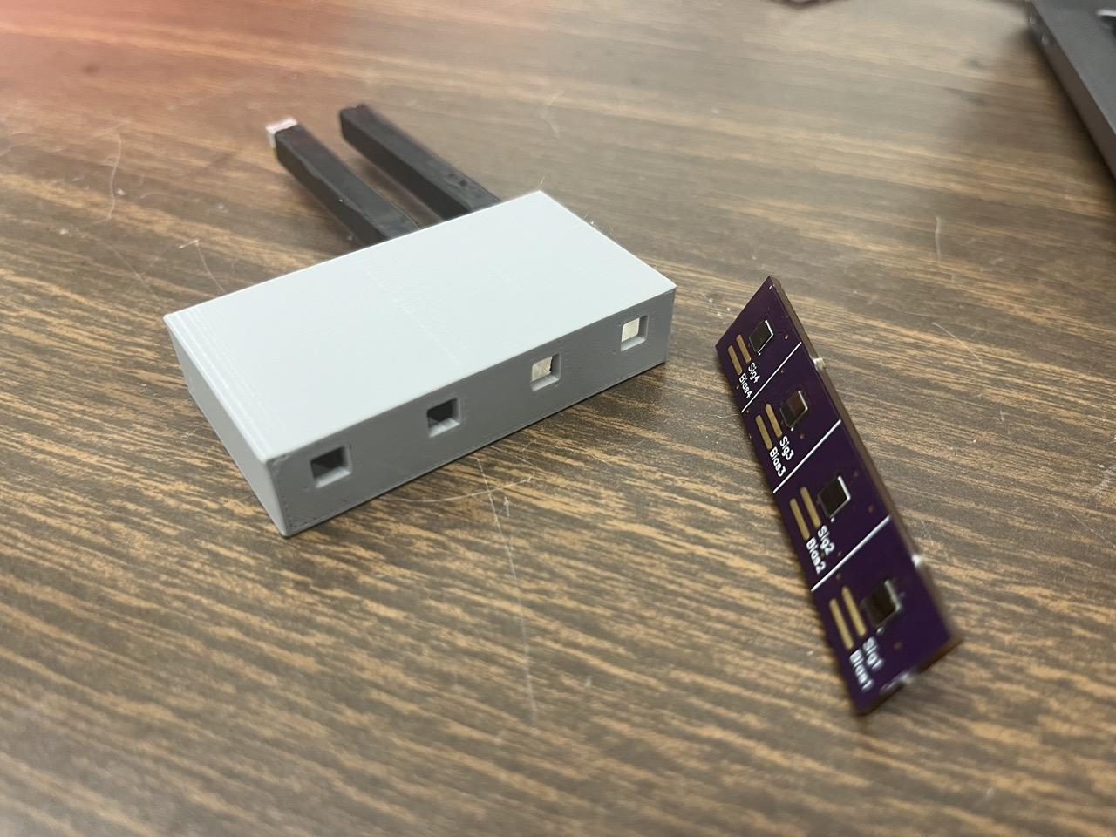
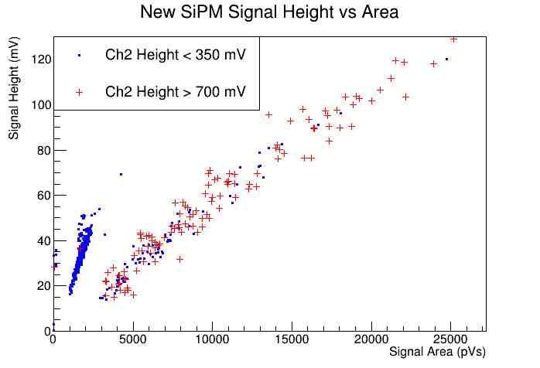
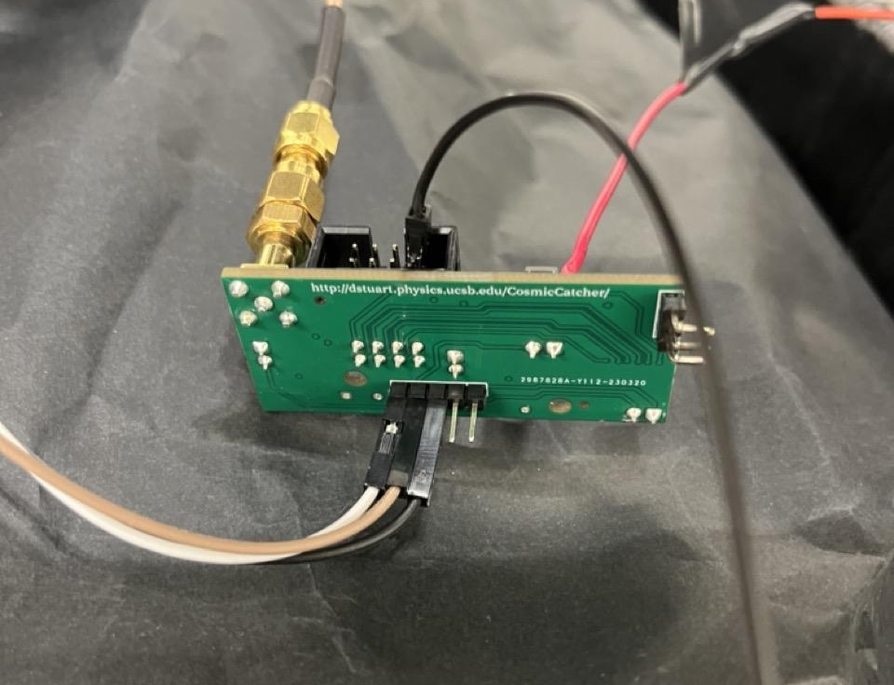
Testing New SiPMs
Less sensitive than Hamamatsu SiPM
Require external amplification
Characterizing noise and signal pulses

Slide 15
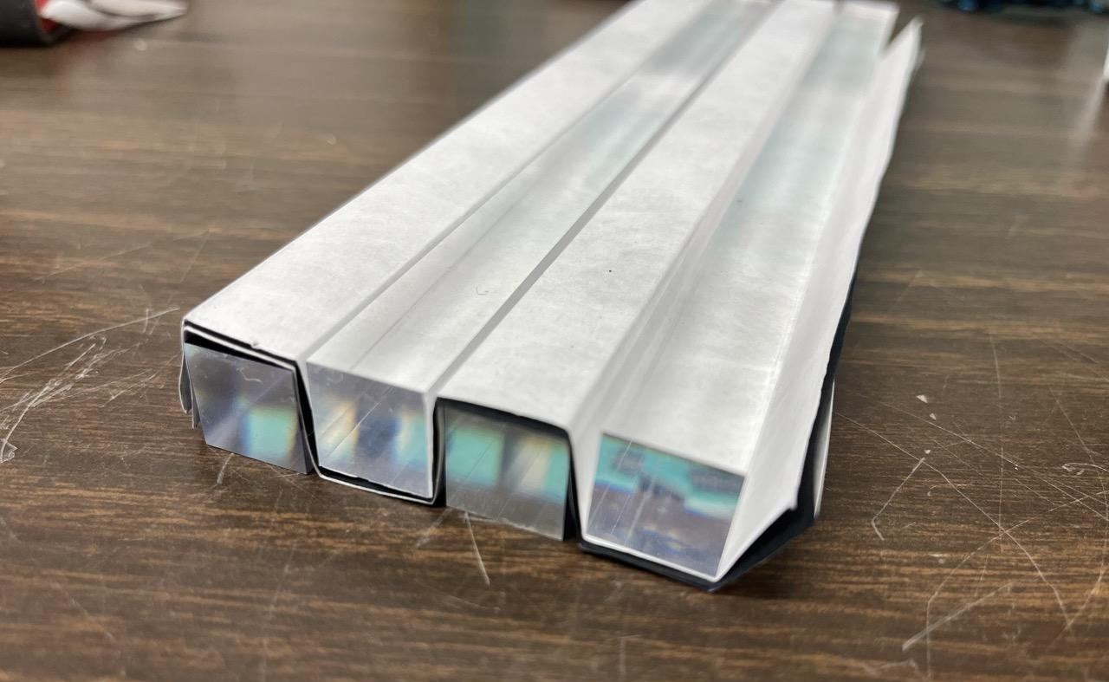
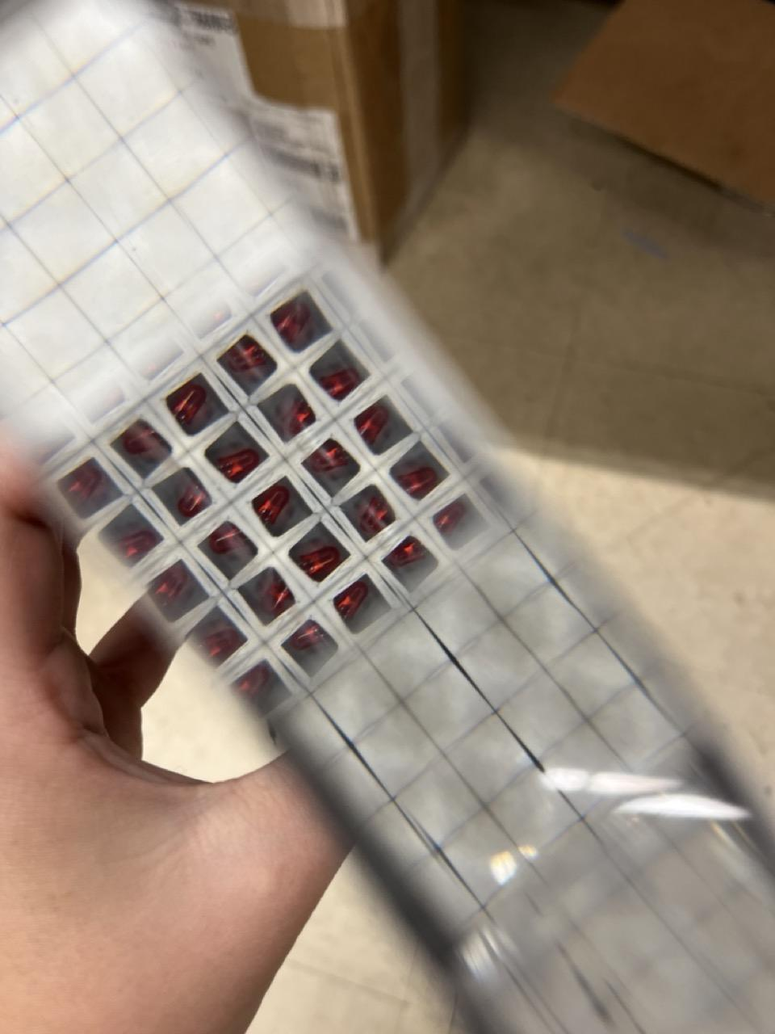
Building a Hodoscope Pack
Ensure no photons leak between the bars
Layers of paper: white, black, white
Wrapped in black tape

Slide 16
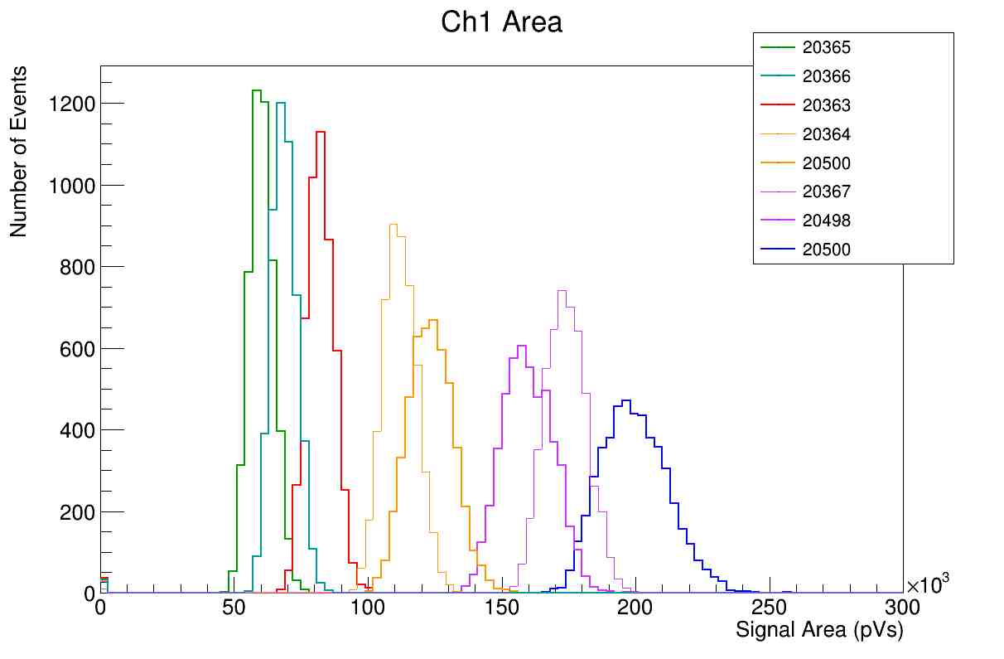
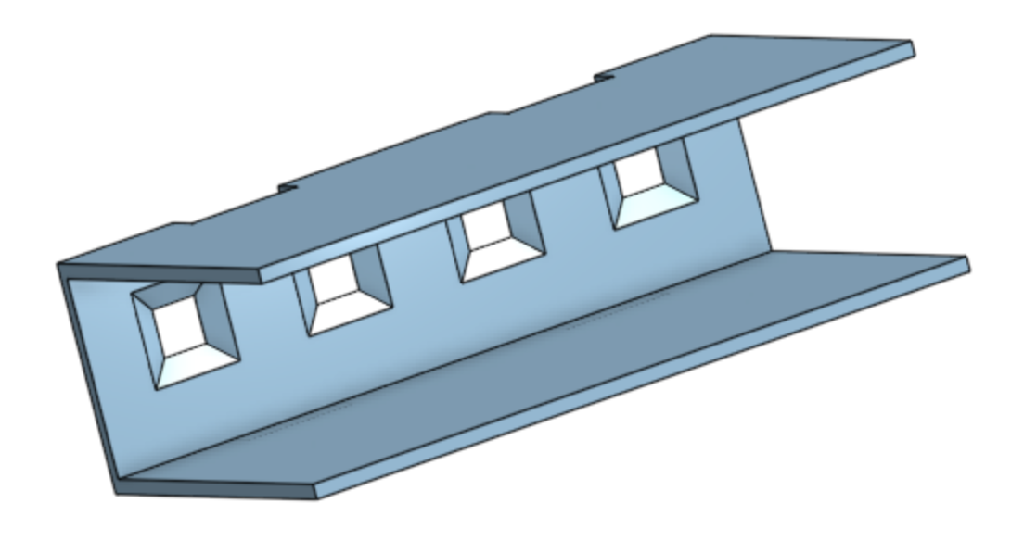
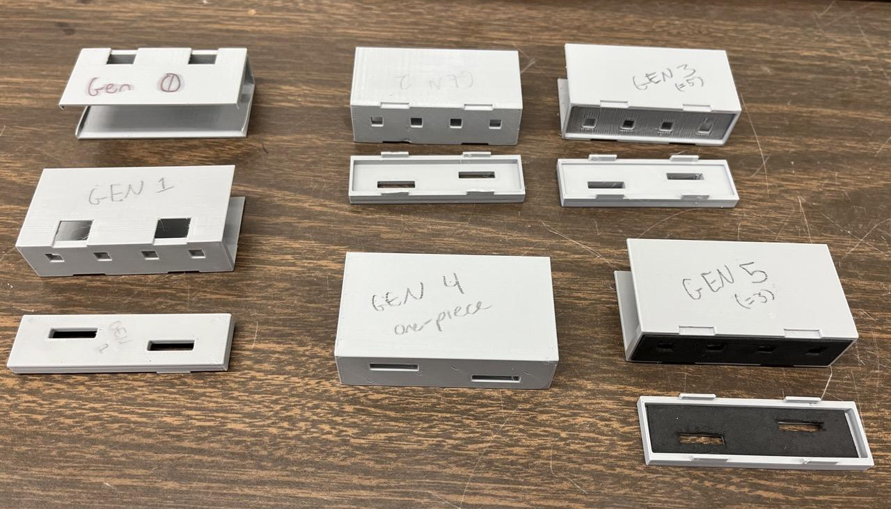
Designing and Testing SiPM Mounts

Slide 17
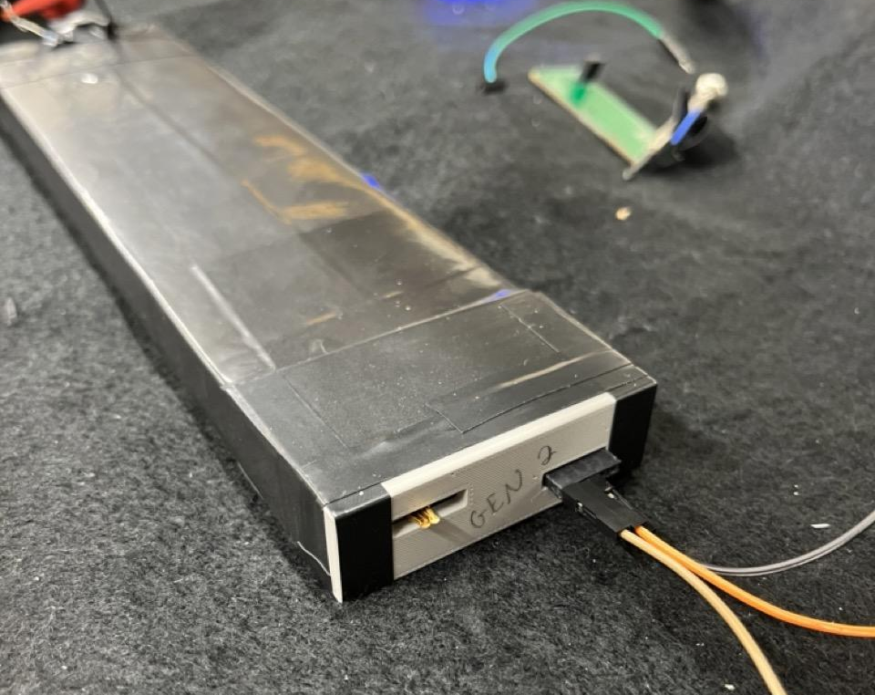
Electronics Flow
Amplifier Board
Digitizer Board
Raspberry Pi Pico

Slide 18
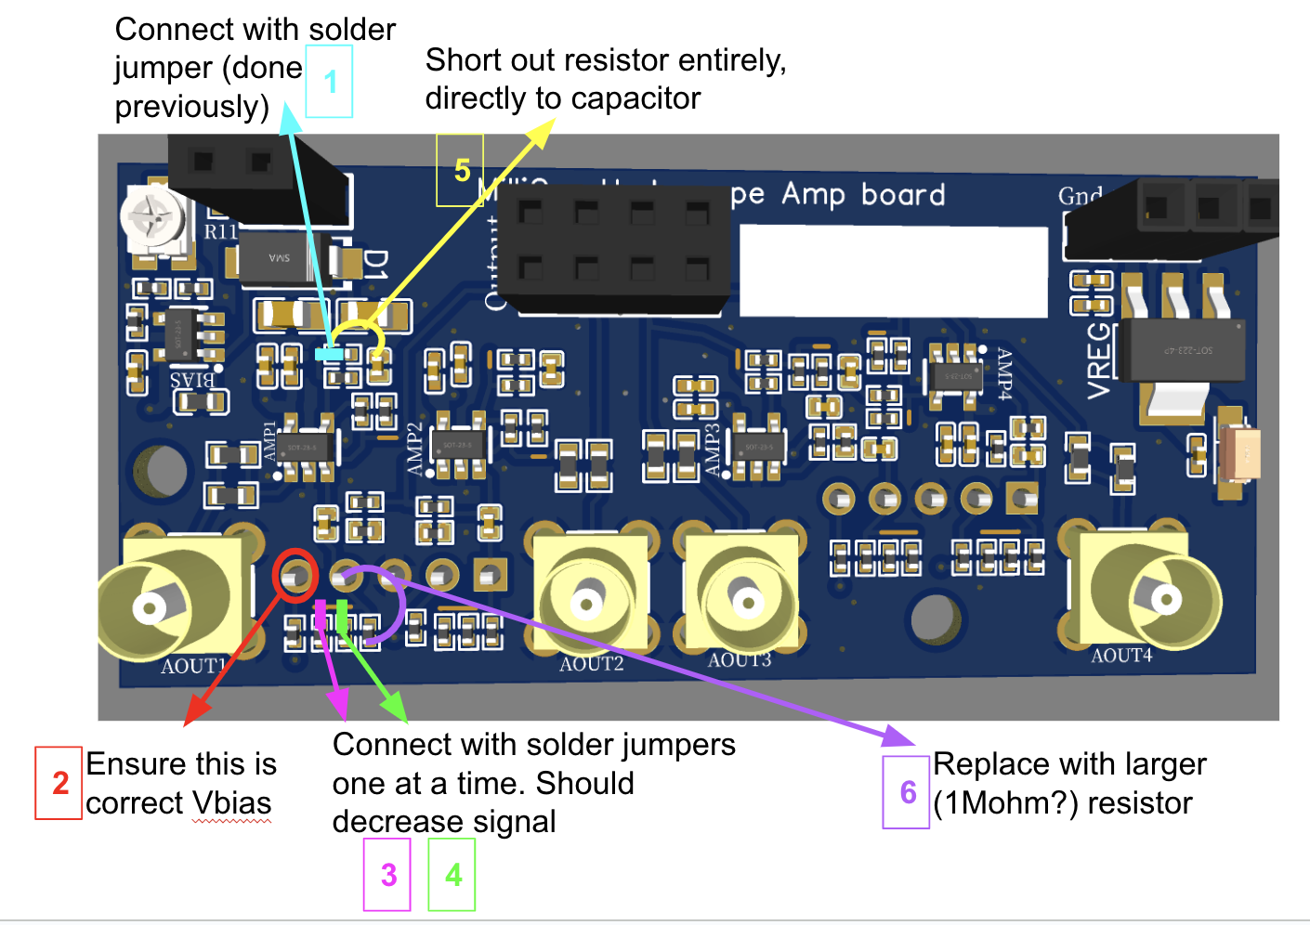
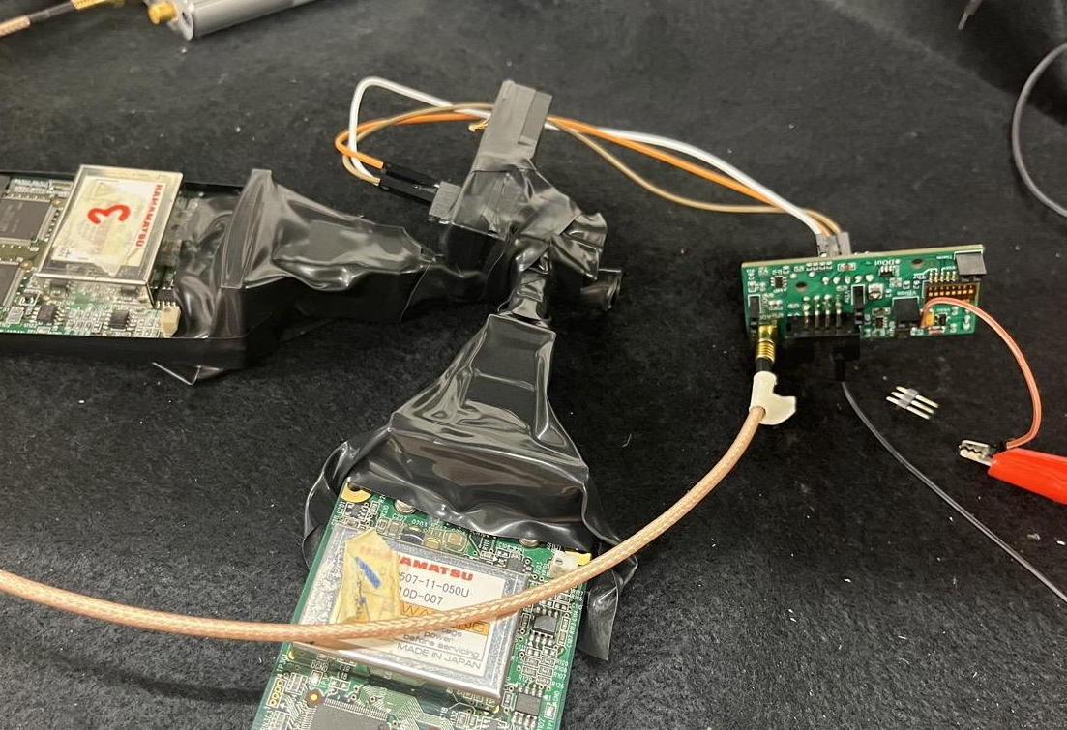
Amplifier Board
Currently in the troubleshooting stage
It is responds to bright LED pulses but not dimmer events such as cosmics or radioactive sources
Two possibilities:
The board isn’t amplifying the signal enough
The SiPMs aren’t sensitive enough to pick up on small muon events (in a large bar)

Slide 19
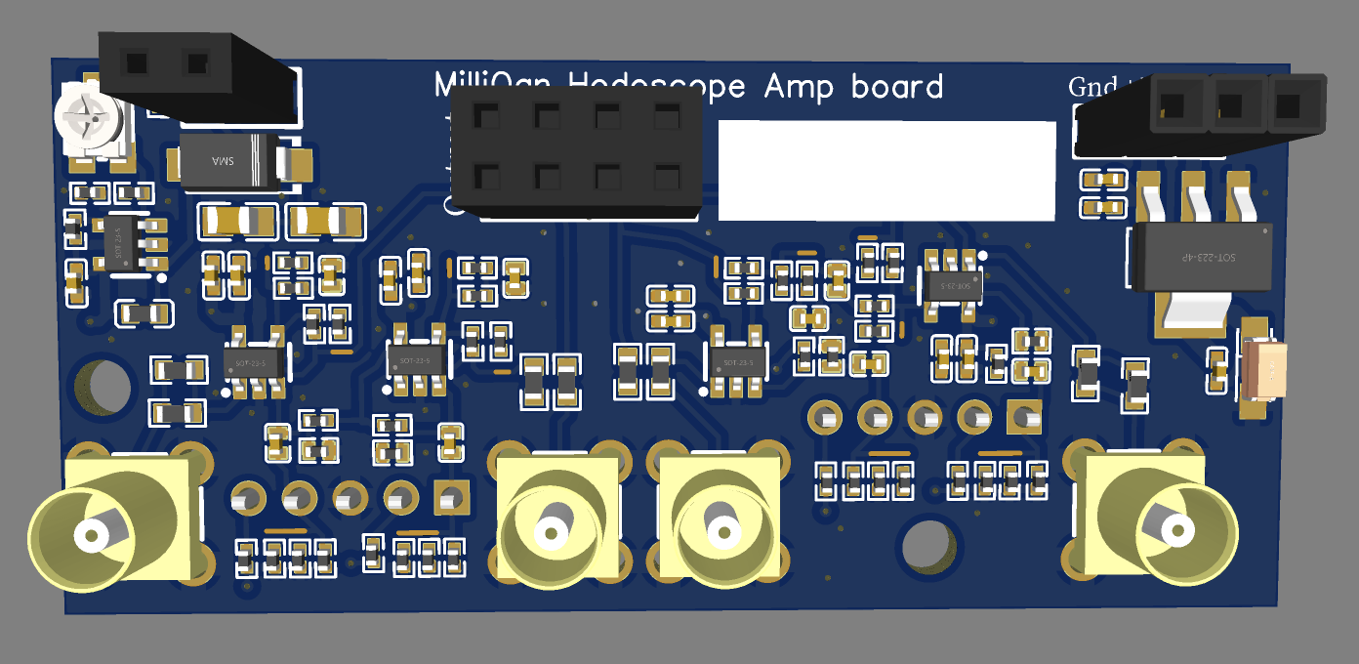
Amplifier Board Overview
SiPM Signal Inputs
Converts a time-varying current to an amplified voltage signal
Input Resistors
Amplification Circuits
Analog Signal Outputs
Output
Amplified Voltage
Each Channel:
Input Current

Slide 20
Amplifier Board Overview
Adjustments Made:
Improved voltage regulator
Increased resistor values providing DC offset
Added resistors to adjust gain and reduce noise
Modified SiPM board for better alignment

Slide 21
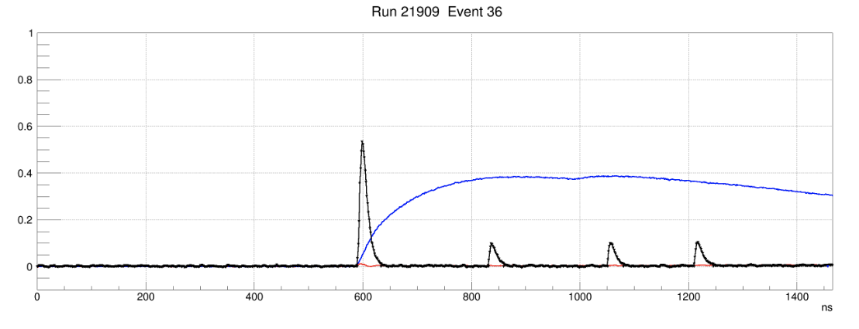
Amplified Signal

Slide 22
Electronics Flow
Amplifier Board
Digitizer Board
Raspberry Pi Pico

Slide 23
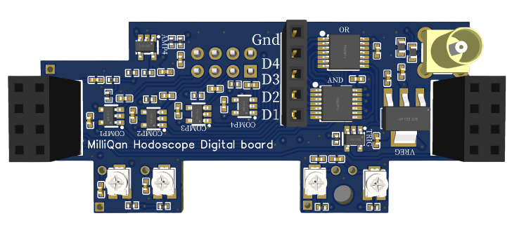
Digital Board Overview
Digital Signal Output
Analog Signal Inputs
Inter-Board Connections and Logic
Converts analog signals into digital pulses
Comparator Circuits
Threshold Adjustment
Other Channels
Other Boards
Input Amplified Voltage
Logic Outputs
AND
Digital Output
Comparator
Threshold Voltage
OR
Logic Outputs
Other Channels
Other Boards

Slide 24
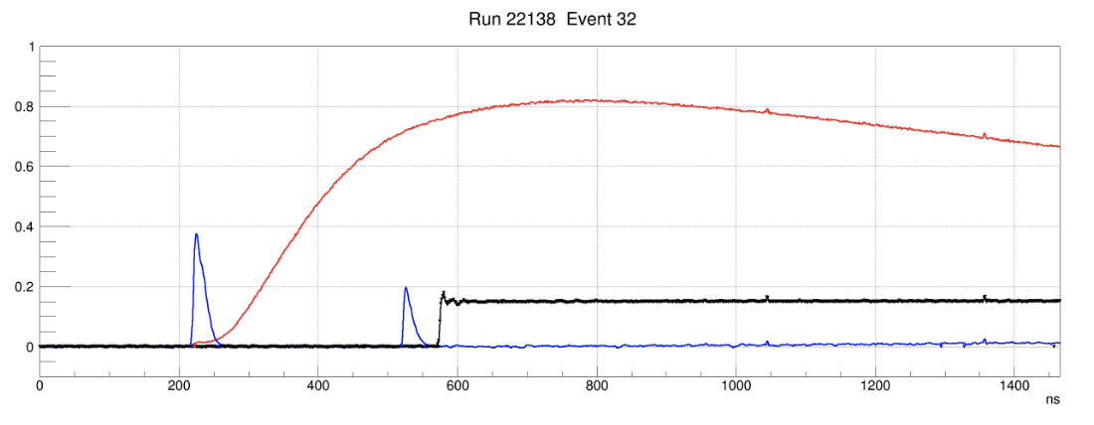
Digital Signal
Analog Signal (Input)
V_{th}
V_{threshold}

Slide 25
Electronics Flow
Amplifier Board
Digitizer Board
Raspberry Pi Pico

Slide 26
Readout
Digital Board 1
Digital Board 3
Pico
Digital Board 2
Digital Board 4

Slide 27
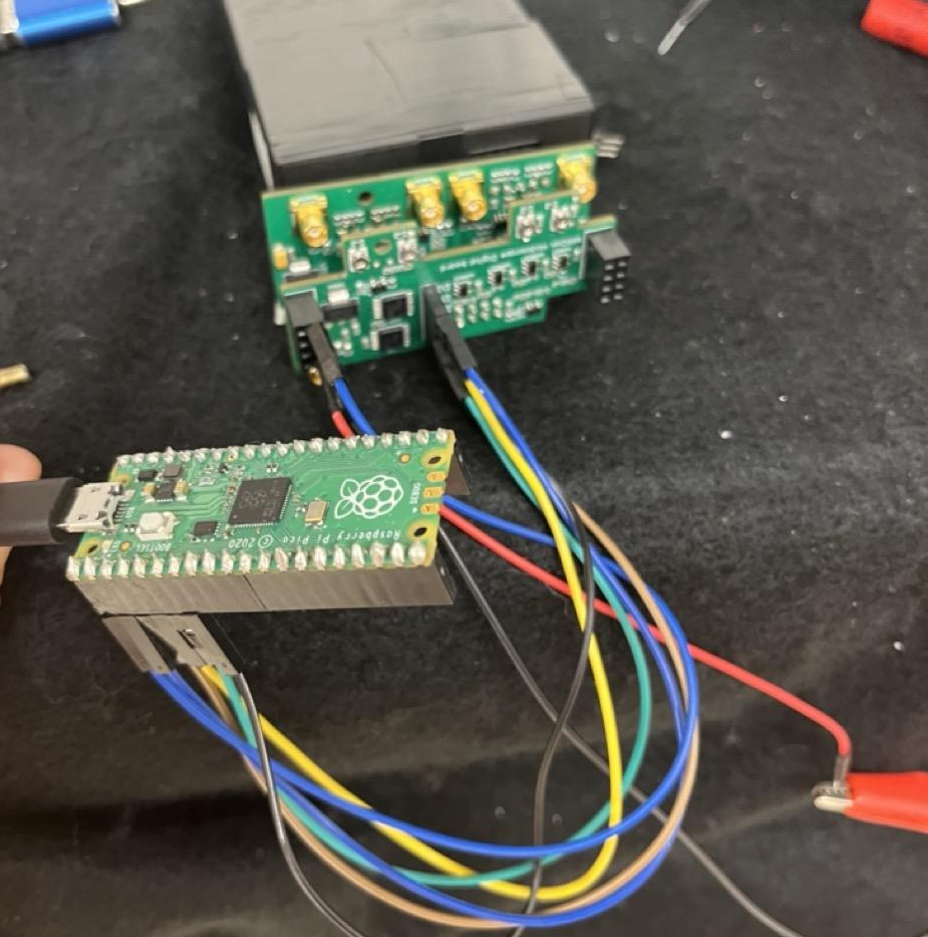
Electronics Flow
Amplifier Board
Digitizer Board
Raspberry Pi Pico

Slide 28
Pico Digital Analysis using PIO
Digital signal pulse widths can be very narrow:
Between 500-5,000 ns
Too brief for typical pulse measurement techniques using micropython
Programmable Input/Output (PIO) capabilities
Extremely direct, but very limited
Can only trigger on one pin
Records the values of all pins at once
Can only remember up to 8 reads
Only 9 commands

Slide 29
V
Pin 1
t (ns)
Rising edge triggers start of data collection
1
1
1
1
1
1
0
0

Slide 30
V
Pin 1
V
t (ns)
1
1
1
1
1
1
0
0
Pin 2
t (ns)
0
0
0
1
1
0
0
0

Slide 31
Each event gives an output of 8 32-bit integers
Pin 1
1
1
1
1
1
1
0
0
Pin 1
Pin 2
Measurement 1
10000010000000000000000000000000
10100010000000000000000000000000
10100110000000000000000000000000
11100110000000000000000000000000
11000110000000000000000000000000
00000110000000000000000000000000
00000100000000000000000000000000
00000000000000000000000000000000
0
0
0
1
1
0
0
0
Pin 3
0
1
1
1
0
0
0
0
… etc.
100…
101…

Slide 32
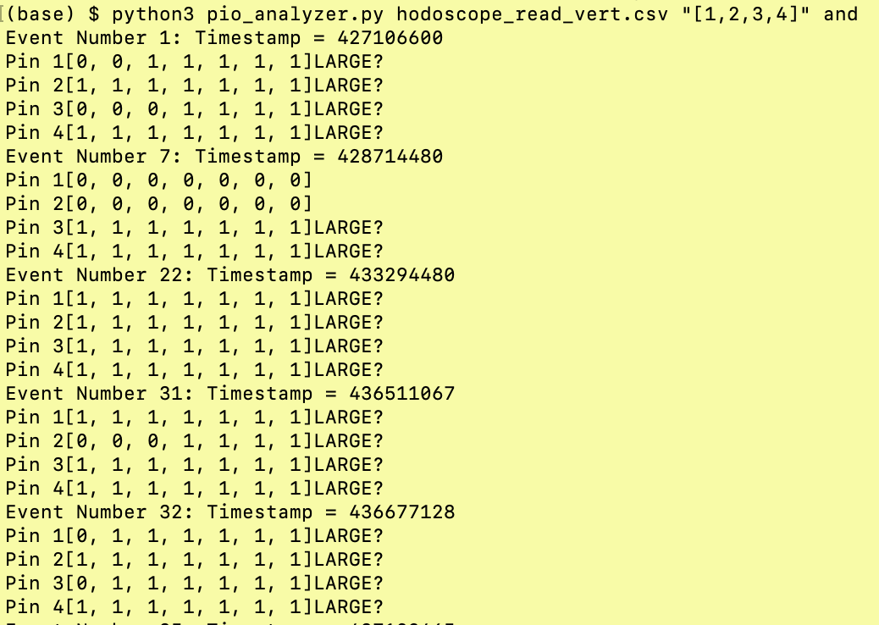
Pin 1
0
0
1
1
1
1
1
1
Pin 2
1
1
1
1
1
1
1
1
Pin 3
0
0
1
1
1
1
1
1
Pin 3
1
1
1
1
1
1
1
1

Slide 33
Putting it all together: Measuring Muons
Using one pack of 4 bars and all electronics from end-to-end
Collected data in two orientations: horizontal and vertical
16/100 events
were coincident on two or more bars
2/100 events
were coincident on two or more bars

Slide 34
Special thanks to:
Graduate mentor Ryan Schmitz
Faculty mentor David Stuart
All members of the Stuart lab and milliQan team
UCSB REU director Sathya Guruswamy
This project was funded by NSF Grant PHY-1852574c

Slide 35
Final Steps and Implementation
Fine-tune electronics to reduce noise and improve confidence
Adjusting V_{bias}, trigger thresholds, and better characterize signals vs. noise
Finish constructing multiple packs to perform multi-pack coincidence and tracking
Order and test readout boards
Allows for assembly of multiple layers
Write a detailed procedure for building and testing the hodoscope and its components

Slide 36
Hodoscope Packs
SiPM Boards
Amp Boards
Digital Boards
Readout Board
Pico

Slide 37
Sources
https://www.sciencedirect.com/science/article/pii/S0370269315003287?via%3Dihub
Description of MilliQan, millicharged particles, BSM theory
https://arxiv.org/abs/1607.04669
Bar detector proposal
https://journals.aps.org/prd/abstract/10.1103/PhysRevD.102.032002
Dark sector, MCPS, demonstrator, simulation
https://journals.aps.org/prd/abstract/10.1103/PhysRevD.104.032002
Dark sector, MCPs, bar detector, simulation
https://arxiv.org/abs/1311.0029
Dark matter, dark sector, other theories, mcps
https://www.sciencedirect.com/science/article/pii/0370269386913778
Holdom’s theory paper, loops, kinetic mixing, u(1) space
https://home.cern/science/physics/cosmic-rays-particles-outer-space
Cosmic rays
https://pubs.aip.org/aip/acp/article/536/1/3/573912/Physics-of-particle-detection
Scintillation, among other things
Thesis, Samuel Alcott
https://home.web.cern.ch/science/physics/standard-model
Standard model
https://home.web.cern.ch/science/physics/dark-matter
Dark matter
https://cds.cern.ch/record/2791279/files/LHCC-P-020.pdf
Technical proposal for MilliQan

